Slide 1
Azure Synapse Analytics + Power BI
Better Together
{Partner Company Name}
{Presenter Name}
{Presenter Title}

Slide 2

The modern data warehouse
LOB sources
Azure
Data Factory
Business services
Azure Synapse Analytics
Logs and streams (unstructured)
Azure Databricks
Power BI
Media (unstructured)
Files (unstructured)
Azure Data
Lake Storage
Notes:
TALK TRACK: Now let’s describe how data warehouse serves a business through a simple architectural diagram.
- The modern data warehouse sits at the heart of enterprise analytics, as a source of sanctioned data, as a system of record and as a hub, serving models for reporting, business intelligence and data science

Slide 3

Azure Synapse Analytics
Limitless analytics service with unmatched time to insight
Limitless Scale
Powerful Insights
Unified Experience
Unmatched Security
Industry-leading performance on demanding workloads
Integration with Power BI and Azure Machine Learning
Data prep and management, big data, and AI in a single workspace
Fine-grained access controls and layers of protection
Notes:
Azure Synapse is the next evolution of Azure Synapse. It gives data professionals the freedom to query data on their terms, using either serverless on-demand or provisioned resources—at limitless scale. With Azure Synapse we are bringing two divided worlds together—relational data and big data—with a unified experience to ingest, prepare, manage, and serve data for immediate BI and machine learning needs.
With limitless scale in Azure Synapse, you are guaranteed industry-leading performance on your demanding workloads, such as enterprise data warehousing and also use the new serverless on-demand query capability to query your data
And you can deliver powerful insights across your business as Azure Synapse is deeply integrated with Power BI and Azure Machine Learning. This will significantly reduce project development time and enable data professionals to apply intelligence over all their most important data—such as data from Dynamics 365, Office 365, to SaaS services that support the Open Data Initiative.
This is all accomplished with a unified experience where data prep, data management, data warehousing, big data, and AI tasks can be done in a single, unified workspace.
And, of course, security is always paramount. Azure Synapse provides fine-grained access control to ensure data stays safe and private.
[click]

Slide 4


Power BI
Import
DirectQuery
Composite Models &
Aggregation Tables
Great for small data sources and personal data discovery
Fine for CSV files, spreadsheet data and summarized OLTP data
The enterprise solution
Avoid data movement
Delegate query work to the back-end source; take advantage of Azure Synapse’s advanced features
Why choose? Import and DirectQuery in a single model
Keep summarized data local; get detail data from the source

Slide 5


Power BI + Azure Synapse Analytics
Industry leading combination for Enterprise Business Intelligence in the Cloud
Azure Synapse
Power BI
Performance
In-Memory
Security
DirectQuery
Workload Management
Composite Models

Slide 6




Azure Synapse performance advantage
Overview
TPC-H 30TB Cloud DW Benchmark
$564
Azure Synapse’s industry leading price-performance comes from leveraging the Azure ecosystem and core SQL Server engine improvements to produce massive gains in performance.
These benefits require no customer configuration and are provided out-of-the-box for every data warehouse
  Gen2 adaptive caching – using non-volatile memory solid-state drives (NVMe) to increase the I/O bandwidth available to queries
  Azure FPGA-accelerated networking enhancements – to move data at rates of up to 1GB/sec per node
  Instant data movement – leverages multi-core parallelism in underlying SQL Servers to move data efficiently between compute nodes
  Query Optimization – ongoing investments in distributed query optimization
$152
$103
$110
$40
$33
$47
$54
$48
$51
DW5000C
DW15000C
DW30000C
2X-Large
3X-Large
4X-Large
BigQuery
dc2.8xlarge 10N
dc2.8xlarge 30N
dc2.8xlarge 60N
Azure Synapse
Snowflake
Google
Redshift
TPC-DS 30TB Cloud DW Benchmark
$1310
$570
$286
$206
$309
$153
Azure Synapse
Amazon Redshift
Snowflake Standard
Snowflake Enterprise
Google
BigQuery Flat Rate
Google BigQuery Per Byte

Slide 7








Performance Optimized Storage
Elastic Architecture
Columnar Storage
Columnar Ordering
Table Partitioning
Secondary Indexes
Hash Distribution
Materialized Views
Resultset Cache

Slide 8
Scaling to Petabytes
Materialized Views
CREATE MATERIALZIED VIEW vw_ProductSales
WITH (DISTRIBUTION = HASH(ProductKey))
AS
SELECT
ProductName
ProductKey,
SUM(Amount) AS TotalSales
FROM
FactSales fs
INNER JOIN DimProduct dp ON fs.prodkey = dp.prodkey
GROUP BY
ProductName,
ProductKey
Transactional consistently to data modification
Automatic Query Optimizer matching

Slide 9

Scaling to Petabytes
Materialized Views
CREATE MATERIALZIED VIEW mvw_ProductSales
WITH (DISTRIBUTION = HASH(ProductKey))
AS
SELECT
ProductName
ProductKey,
SUM(Amount) AS TotalSales
FROM
FactSales fs
INNER JOIN DimProduct dp
ON fs.prodkey = dp.prodkey
GROUP BY
ProductName,
ProductKey
FactSales Table
10B Records
DimProduct Table
1,000 Records
Materialized View (1000 Records)
Transactional consistently to data modification
Automatic Query Optimizer matching
ProductName | ProductKey | TotalSales
Product A | 5453 | 784,943.00
Product B | 763 | 48,723.00
… | … | …
SELECT
<COLUMNS>
FROM FactSales fs
INNER JOIN
(
SELECT
ProductName
ProductKey,
SUM(Amount) AS TotalSales
FROM
FactSales fs
INNER JOIN DimProduct dp
GROUP BY
ProductName,
ProductKey ) ps
  INNER JOIN FactInventory
  GROUP BY …
FactInventory Table
mvw_ProductSales
1,000 Records

Slide 10


Scaling to Petabytes
Result set cache
  SELECT
  ProductName
  ProductKey,
  SUM(Amount) AS TotalSales
  FROM
  Fact Sales
  INNER JOIN DimProduct
  GROUP BY
  ProductName,
  ProductKey
Automatic query matching
Implicit creating from query activity
Resilient to cluster elasticity
Execution 2
Cache Hit
Resultset
Cache
~.2 seconds
Execution 1
Cache Miss
Regular Execution
Data Warehouse

Slide 11
Complete security
Category | Feature | Azure Synapse
Data Protection | Data In Transit | Yes
 | Data encryption at rest (Service & User Managed Keys) | Yes
 | Data Discovery and Classification | Yes
Access Control | Native Row Level Security | Yes
 | Table and View Security (GRANT / DENY) | Yes
 | Column Level Security | Yes
 | Dynamic Data Masking | Yes
Authentication | SQL Authentication | Yes
 | Native Azure Active Directory | Yes
 | Integrated Security | Yes
 | Multi-Factor Authentication | Yes
Network Security | Virtual Network (VNET) | Yes
 | SQL Firewall (server) | Yes
 | Integration with ExpressRoute | Yes
Threat Protection | SQL Threat Detection | Yes
 | SQL Auditing | Yes
 | Vulnerability Assessment | Yes

Slide 12
Row-level security (RLS)
Overview
Fine grained access control of specific rows in a database table.
Help prevent unauthorized access when multiple users share the same tables.
Eliminates need to implement connection filtering in multi-tenant applications.
Administer via SQL Server Management Studio or SQL Server Data Tools.
Easily locate enforcement logic inside the database and schema bound to the table.
Customer 1
Customer 2
Customer 3
Azure Synapse
Notes:
Objective: Row-Level Security (RLS) simplifies the design and coding of security in your application.
Talking Points:
RLS enables you to implement restrictions on data row access. For example, ensuring that workers can access only those data rows that are pertinent to their department, or restricting a customer's data access to only the data relevant to their company.
The access restriction logic is located in the database tier rather than away from the data in another application tier. The database system applies the access restrictions every time that data access is attempted from any tier. This makes your security system more reliable and robust by reducing the surface area of your security system.
Implement RLS by using the CREATE SECURITY POLICY Transact-SQL statement, and predicates created as inline table valued functions.
Source: https://docs.microsoft.com/en-us/sql/relational-databases/security/row-level-security?toc=%2Fazure%2Fsql-data-warehouse%2Ftoc.json&view=sql-server-2017

Slide 13
Row-level security
Creating policies
-- The following syntax creates a security policy with a filter predicate for the Customer table
CREATE SECURITY POLICY [FederatedSecurityPolicy]
ADD FILTER PREDICATE [rls].[fn_securitypredicate]([CustomerId])
ON [dbo].[Customer];
-- Create a new schema and predicate function, which will use the application user ID stored in CONTEXT_INFO to filter rows.
CREATE FUNCTION rls.fn_securitypredicate (@AppUserId int)
RETURNS TABLE
WITH SCHEMABINDING
AS
RETURN (
SELECT 1 AS fn_securitypredicate_result
WHERE
DATABASE_PRINCIPAL_ID() = DATABASE_PRINCIPAL_ID('dbo') -- application context
AND CONTEXT_INFO() = CONVERT(VARBINARY(128), @AppUserId));
GO
Filter predicates silently filter the rows available to read operations (SELECT, UPDATE, and DELETE).
The following examples demonstrate the use of the CREATE SECURITY POLICY syntax
Notes:
Objective: Row-level filtering of data selected from a table is enacted through a security predicate filter defined as an inline table valued function. The function is then invoked and enforced by a security policy. The policy can restrict the rows that may be viewed (a filter predicate), but does not restrict the rows that can be inserted or updated from a table (a blocking predicate). There is no indication to the application that rows have been filtered from the result set; if all rows are filtered, then a null set will be returned.
** Azure Synapse doesn’t yet support block predicates.
Talking Points:
Filter predicates are applied while reading data from the base table, and it affects all get operations: SELECT, DELETE (i.e. user cannot delete rows that are filtered), and UPDATE (i.e. user cannot update rows that are filtered, although it is possible to update rows in such way that they will be subsequently filtered). Blocking predicates are not available in this version of RLS, but equivalent functionality (i.e. user cannot INSERT or UPDATE rows such that they will subsequently be filtered) can be implemented using check constraints or triggers.
Filter predicates and security policies have the following behavior:
Define a security policy that filters the rows of a table. The application is unaware that any rows have been filtered for SELECT, UPDATE, and DELETE operations, including situations where all the rows have been filtered out. The application can INSERT any rows, regardless of whether or not they will be filtered during any other operation.
Define a predicate function that joins with another table and/or invokes a function. The join/function is accessible from the query and works as expected without any additional permission checks.
Issue a query against a table that has a security predicate defined but disabled. Any rows that would have been filtered or restricted are not affected.
The dbo user, a member of the db_owner role, or the table owner queries against a table that has a security policy defined and enabled. Rows are filtered/restricted as defined by the security policy.
Attempts to alter the schema of a table bound by a security policy will result in an error. However, columns not referenced by the filter predicate can be altered.
Attempts to add a predicate on a table that already has one defined (regardless of whether it is enabled or disabled) results in an error.
Attempts to modify a function used as a predicate on a table within a security policy results in an error.
Defining multiple active security policies that contain non-overlapping predicates, succeeds.
Source: https://docs.microsoft.com/en-us/sql/relational-databases/security/row-level-security?view=sql-server-2017

Slide 14
Column-level security
Overview
Control access of specific columns in a database table based on customer’s group membership or execution context.
Simplifies the design and implementation of security by putting restriction logic in database tier as opposed to application tier.
Administer via GRANT T-SQL statement.
Both Azure Active Directory (AAD) and SQL authentication are supported.
Notes:
Objective: Column-Level Security (CLS) simplifies the design and coding of security in your application.
Use Cases
Some examples of how CLS is being used today:
A financial services firm allows only account managers to have access to customer social security numbers (SSN), phone numbers, and other personally identifiable information (PII).
A health care provider allows only doctors and nurses to have access to sensitive medical records while not allowing members of the billing department to view this data.
Source: https://docs.microsoft.com/en-us/azure/sql-data-warehouse/column-level-security

Slide 15
Column-level security
Three steps
Policy manager creates permission policy in T-SQL, binding the policy to the Patients table on a specific group.
App user (for example, a nurse) selects from Patients table.
Permission policy prevents access on sensitive data.
Policy manager
Database
CREATE TABLE Patients (
PatientID int IDENTITY,
FirstName varchar(100) NULL,
SSN char(9) NOT NULL,
LastName varchar(100) NOT NULL,
Phone varchar(12) NULL,
Email varchar(100) NULL
);
Patients
Nurse
Application
SELECT * FROM Membership
Msg 230, Level 14, State 1, Line 12
The SELECT permission was denied on the column 'SSN' of the object 'Membership', database 'CLS_TestDW', schema 'dbo'.
GRANT SELECT ON Patients (
PatientID, FirstName, LastName, Phone, Email
) TO Nurse;
Permission policy
Queries executed as ‘Nurse’ will fail if they include the SSN column
Allow ‘Nurse’ to access all columns except for sensitive SSN column
Notes:
Talking Points:
Policy manager creates permission policy on Nurse against Patients table
App user (e.g., a nurse) selects from the patient’s table
The query is rejected if it violates permission policy
* Notice: No app changes!

Slide 16
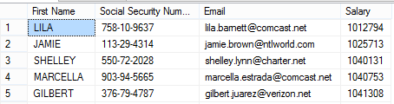
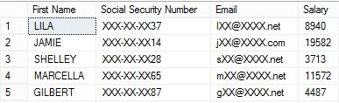
Dynamic Data Masking
Three steps
2
Security officer defines dynamic data masking policy in T-SQL over sensitive data in the Employee table. The security officer uses the built-in masking functions (default, email, random)
The app-user selects from the Employee table
The dynamic data masking policy obfuscates the sensitive data in the query results for non-privileged users
SELECT [First Name],
[Social Security Number],
[Email],
[Salary]
FROM [Employee]
Business app
Non-masked data (admin login)
3
ALTER TABLE [Employee]
ALTER COLUMN [SocialSecurityNumber]
ADD MASKED WITH (FUNCTION = 'DEFAULT()')
ALTER TABLE [Employee]
ALTER COLUMN [Email]
ADD MASKED WITH (FUNCTION = 'EMAIL()')
ALTER TABLE [Employee]
ALTER COLUMN [Salary]
ADD MASKED WITH (FUNCTION = 'RANDOM(1,20000)')
GRANT UNMASK to admin1
1
Masked data (admin1 login)
Security officer
Notes:
Objective: Dynamic data masking limits sensitive data exposure by masking it to non-privileged users.
Talking Points:
Dynamic data masking helps prevent unauthorized access to sensitive data by enabling customers to designate how much of the sensitive data to reveal with minimal impact on the application layer. It’s a policy-based security feature that hides the sensitive data in the result set of a query over designated database fields, while the data in the database is not changed.
For example shown above, a security officer defines the masking policy in T_SQL over sensitive data at Employee table . Any app user, issue select query from the Employee table but those data items should not be fully exposed. A masking rule can be defined that masks all but the last four digits of any Social Security number or credit card number in the result set of any query. As another example, an appropriate data mask can be defined to protect personally identifiable information (PII) data, so that a developer can query production environments for troubleshooting purposes without violating compliance regulation.

Slide 17




Workload Management
Workload Importance
Scheduler Without Importance
CEO
CEO
CEO
1
2
3
9
4
5
10
6
7
8
10
9
11
12
10
11
12
Running
Queued
Queued
Queued
By default, workloads are run on a first-in first-out basis.

Slide 18

Workload Management
Workload Importance
CREATE WORKLOAD CLASSIFIER classifier_name
WITH
(
WORKLOAD_GROUP = 'name’ ,
MEMBERNAME = 'security_account' [ [ , ]
IMPORTANCE = { LOW | BELOW_NORMAL | NORMAL (default) | ABOVE_NORMAL | HIGH }])
Scheduler With Importance Turned On
CEO
CEO
1
2
3
12
4
5
6
7
8
9
10
11
12
Normal
Low
Normal
High
Running
Queued
Queued

Slide 19
Power BI
Import
DirectQuery
Composite Models &
Aggregation Tables
Great for small data sources and personal data discovery
Fine for CSV files, spreadsheet data and summarized OLTP data
The enterprise solution
Avoid data movement
Delegate query work to the back-end source; take advantage of Azure Synapse’s advanced features
Why choose? Import and DirectQuery in a single model
Keep summarized data local; get detail data from the source

Slide 20
DirectQuery
Import
Geography
Geography
Customer
Customer
Sales
Sales
Date
Date
Product
Product
Reseller Sales
Reseller Sales
Employee
Employee

Slide 21
DirectQuery
&
Import
Geography
Geography
Customer
Customer
Sales
Sales
Date
Date
Product
Product
Reseller Sales
Reseller Sales
Employee
Employee

Slide 22
DirectQuery & Import
Geography
Geography
Customer
Customer
Sales Agg
Sales
Date
Date
Product
Product
Reseller Sales
Reseller Sales
Employee
Employee

Slide 23
Aggregations
Geography
Geography
Sales Agg
Customer
Customer
Sales
Date
Date
Product
Product
Reseller Sales
Reseller Sales
Employee
Employee

Slide 24
Aggregations
SummarizeColumns(
Date[Year],
Geography[City],
"Sales", Sum(Sales[Amount])
)
Geography
Geography
Sales Agg
Customer
Customer
Sales
Date
Hits in-memory cache
Date
Product
Product
Reseller Sales
Reseller Sales
Employee
Employee

Slide 25
Aggregations
SummarizeColumns(
Date[Year],
Geography[City],
"Sales", Sum(Sales[Amount])
)
Geography
Geography
Sales Agg
Customer
Customer
Sales
Date
DirectQuery
Date
Product
Product
SELECT [Year],
[Name],
SUM([Amount]) AS [Amount]
FROM [Sales]
INNER JOIN [Date] ON ...
INNER JOIN [Customer] ON ...
GROUP BY [Year],
[Name]
Reseller Sales
Reseller Sales
Employee
Employee

Slide 26
In preview
Azure Synapse + Power BI integration

Slide 27
Build Power BI dashboards directly from Azure Synapse (preview)
Azure Synapse + Power BI integration

Slide 28
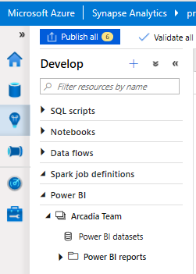
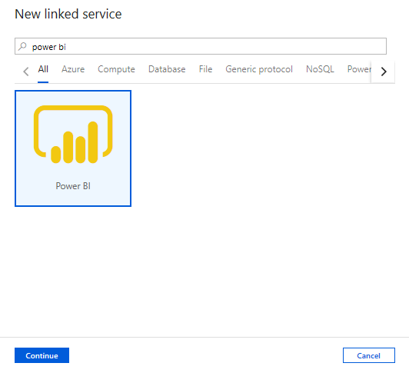
Develop Hub – Power BI
Overview
Create Power BI reports in the workspace
Provides access to published reports in the workspace
Update reports real time from Synapse workspace to get it reflected on Power BI service
Visually explore and analyze data

Slide 29
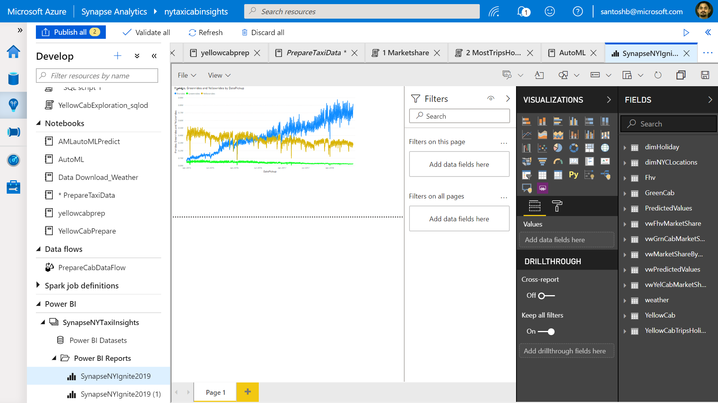
Develop Hub – Power BI
View published reports in Power BI workspace

Slide 30
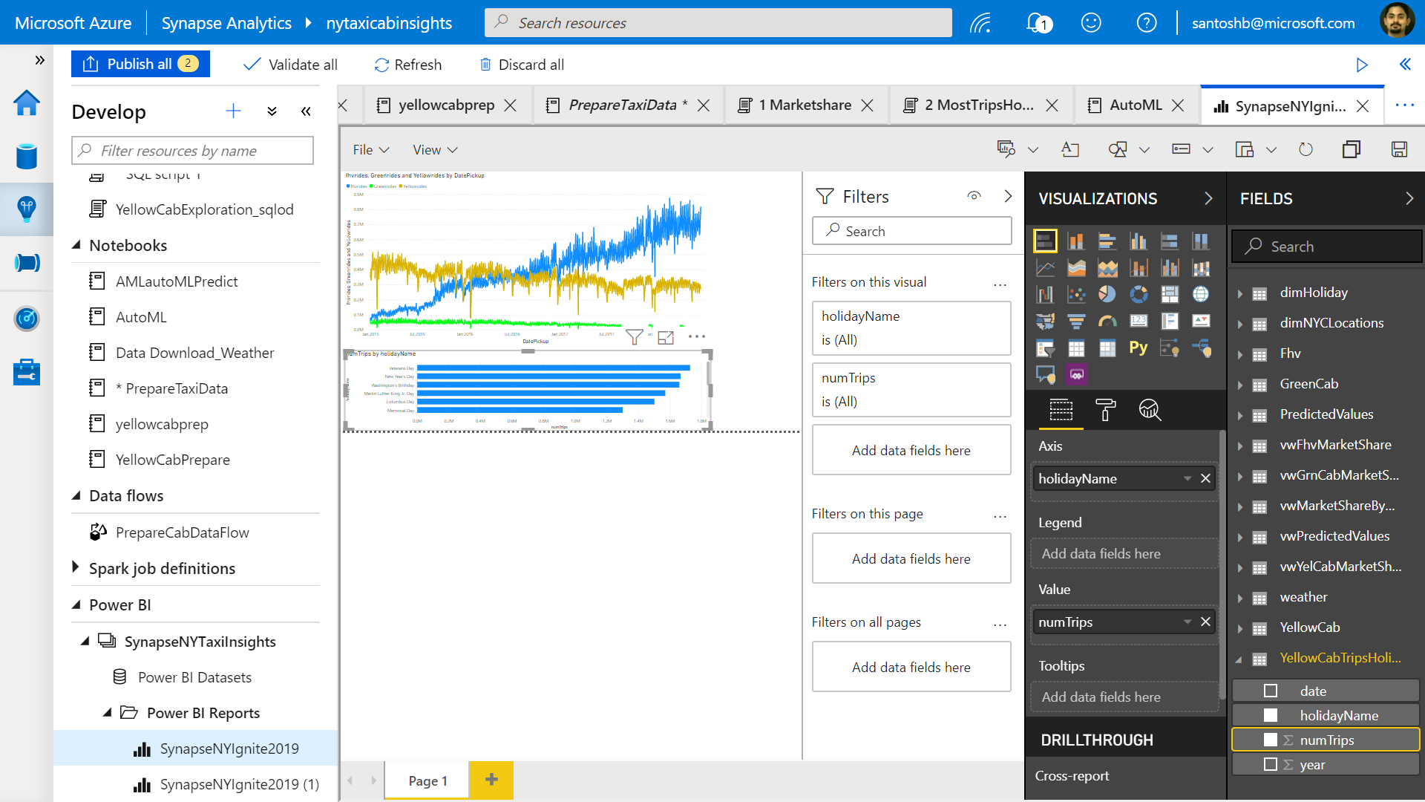
Develop Hub – Power BI
Edit reports in Synapse workspace

Slide 31
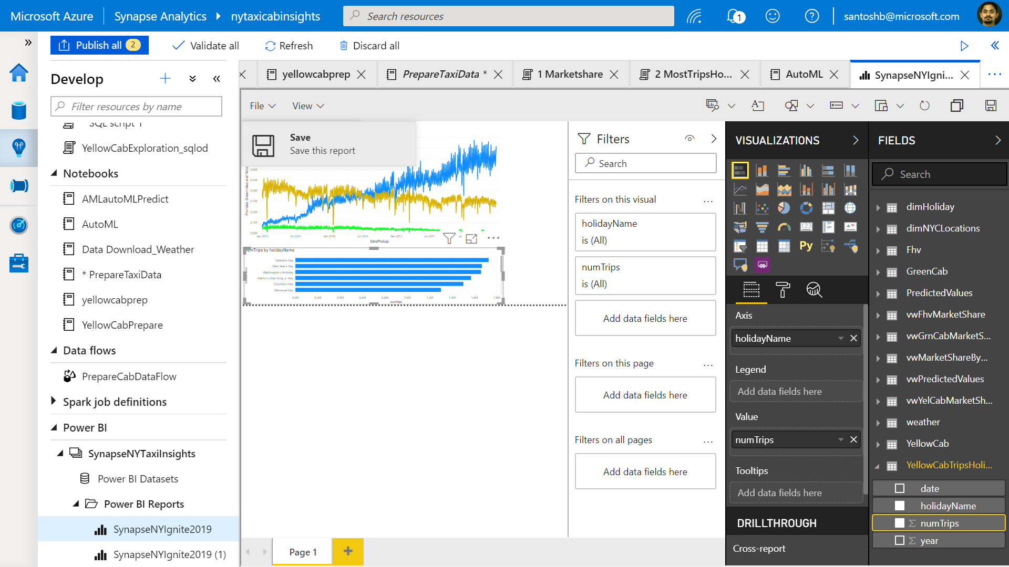
Develop Hub – Power BI
Publish edited reports in Synapse workspace to Power BI workspace
Publish changes by simple save report in workspace

Slide 32
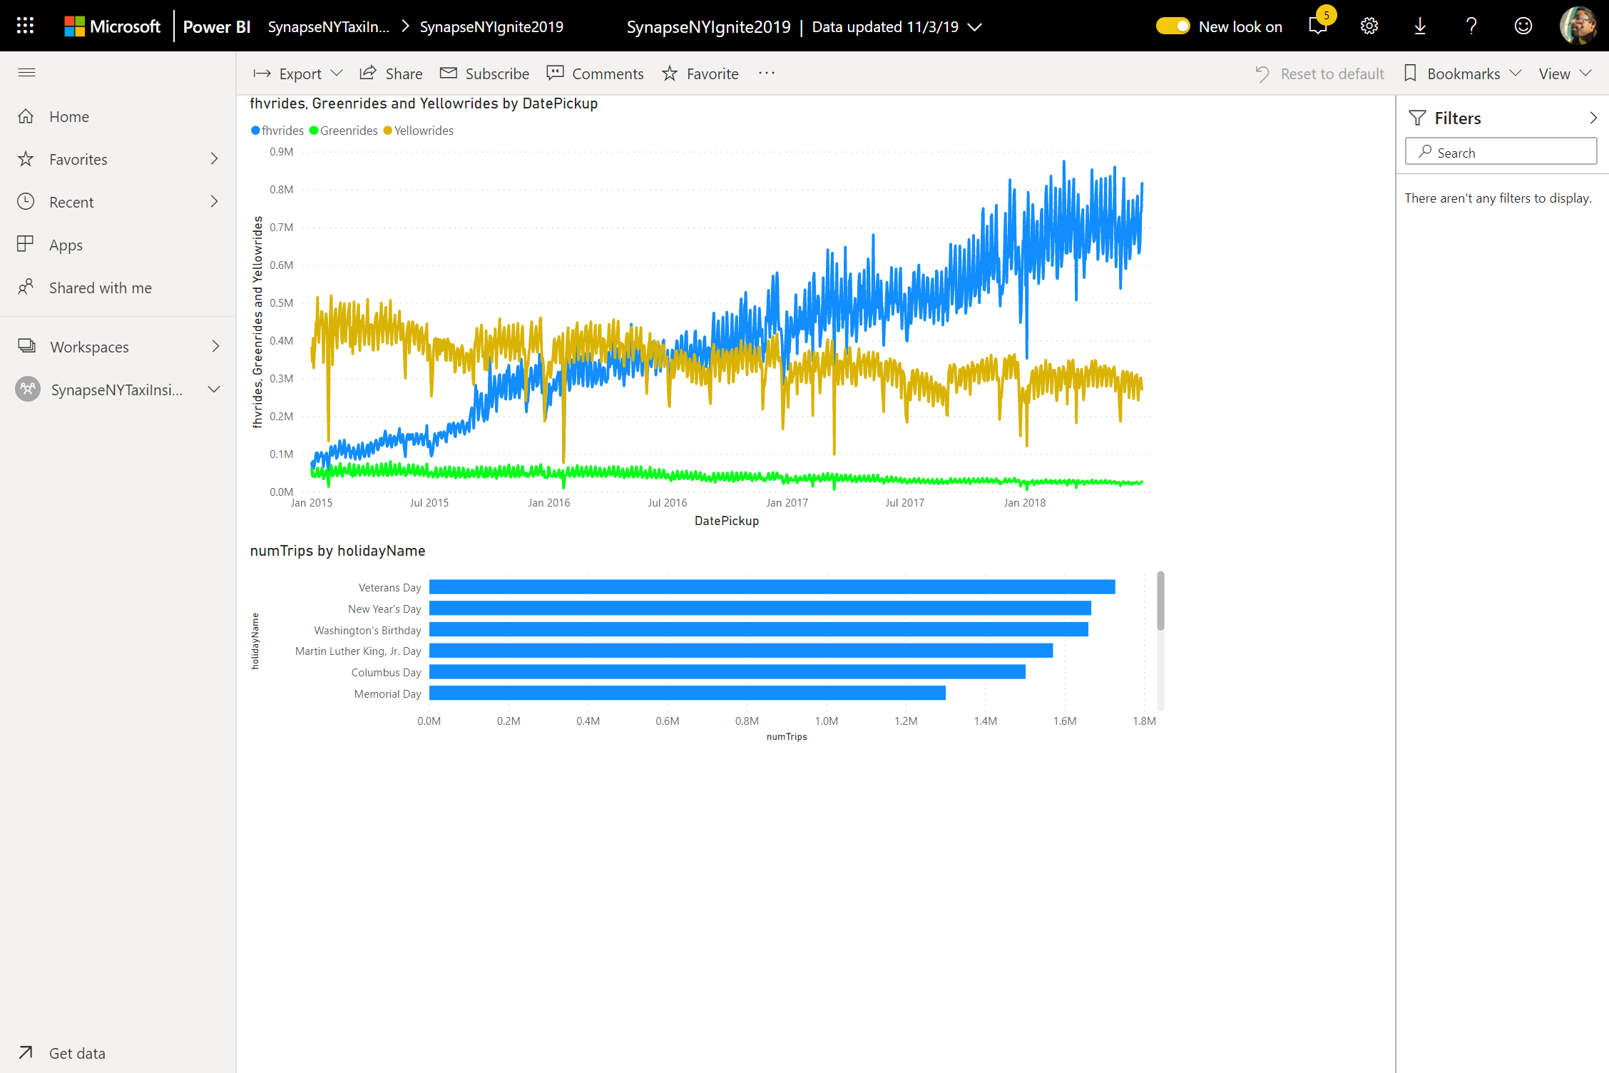
Develop Hub – Power BI
Real-time publish on save

