Slide 1

Business ByDesign Enablement
Customer Engagement & Commerce Integration (aka CRM Integration)
June 2020

Slide 2
Disclaimer
  The information in this presentation is confidential and proprietary to SAP and may not be disclosed without the permission of SAP. Except for your obligation to protect confidential information, this presentation is not subject to your license agreement or any other service or subscription agreement with SAP. SAP has no obligation to pursue any course of business outlined in this presentation or any related document, or to develop or release any functionality mentioned therein.
  This presentation, or any related document and SAP's strategy and possible future developments, products and or platforms directions and functionality are all subject to change and may be changed by SAP at any time for any reason without notice. The information in this presentation is not a commitment, promise or legal obligation to deliver any material, code or functionality. This presentation is provided without a warranty of any kind, either express or implied, including but not limited to, the implied warranties of merchantability, fitness for a particular purpose, or non-infringement. This presentation is for informational purposes and may not be incorporated into a contract. SAP assumes no responsibility for errors or omissions in this presentation, except if such damages were caused by SAP’s intentional or gross negligence.
  All forward-looking statements are subject to various risks and uncertainties that could cause actual results to differ materially from expectations. Readers are cautioned not to place undue reliance on these forward-looking statements, which speak only as of their dates, and they should not be relied upon in making purchasing decisions.

Slide 3
Disclaimer
  Die Informationen in dieser Präsentation sind vertraulich und urheberrechtlich geschützt und dürfen nicht ohne Genehmigung von SAP offengelegt werden. Diese Präsentation unterliegt weder Ihrem Lizenzvertrag noch einer anderen Service- oder Subskriptionsvereinbarung mit SAP. SAP ist in keiner Weise verpflichtet, in dieser Präsentation oder einem dazugehörigen Dokument dargestellte Geschäftsabläufe zu verfolgen oder hierin wiedergegebene Funktionen zu entwickeln oder zu veröffentlichen.
  Diese Präsentation oder jedes dazugehörige Dokument über die Strategie von SAP und mögliche zukünftige Entwicklungen, Ausrichtungen und Funktionen von Produkten und/oder Plattformen kann von SAP jederzeit aus beliebigen Gründen ohne vorherige Ankündigung geändert werden. Die Informationen in dieser Präsentation stellen keinerlei Zusage, Versprechen oder rechtliche Verpflichtung zur Auslieferung von Materialien, Code oder Funktionen dar. Diese Präsentation wird ohne jegliche Gewähr, weder ausdrücklich noch stillschweigend, bereitgestellt. Dies gilt insbesondere, hinsichtlich der Gewährleistung der Marktgängigkeit und der Eignung für einen bestimmten Zweck sowie für die Gewährleistung der Nichtverletzung geltenden Rechts. Diese Präsentation dient zu Informationszwecken und darf nicht in einen Vertrag eingebunden werden. SAP übernimmt keine Verantwortung für Fehler oder Unvollständigkeiten in dieser Präsentation, es sei denn, solche Schäden wurden von SAP vorsätzlich oder grob fahrlässig verursacht. Sämtliche vorausschauenden Aussagen unterliegen verschiedenen Risiken und Unsicherheiten, durch die die tatsächlichen Ergebnisse von den Erwartungen abweichen können.
  Die vorausschauenden Aussagen geben die Sicht zu dem Zeitpunkt wieder, zu dem sie getätigt wurden. Dem Leser wird empfohlen, diesen Aussagen kein übertriebenes Vertrauen zu schenken und sich bei Kaufentscheidungen nicht auf sie zu stützen.

Slide 4

The goals of this slide deck
At the end of this presentation, you will be able to:
  Give an overview on customer engagement & commerce (aka CRM) integration
  Explain what is new in the latest release
The content of this presentation might only be used for self-enablement purposes. The usage of the content as part of any commercial training offering is strictly prohibited.

Slide 5
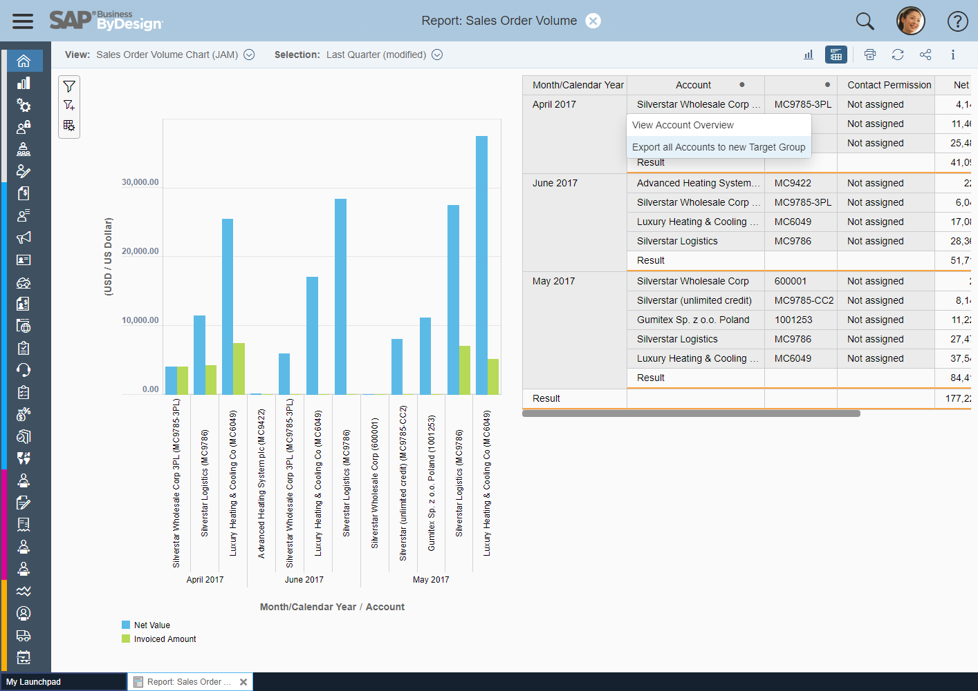
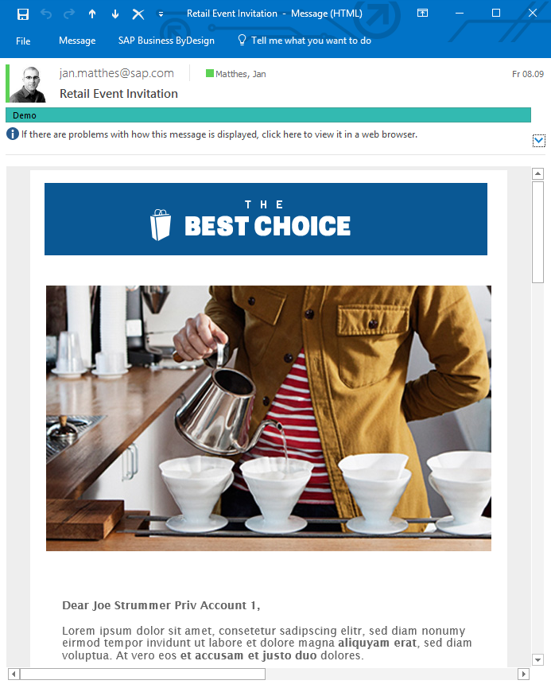
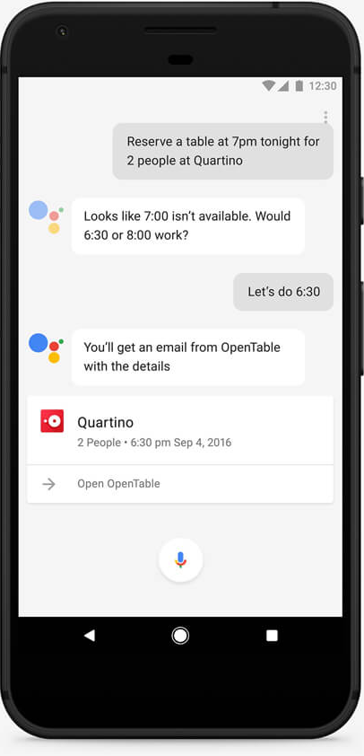
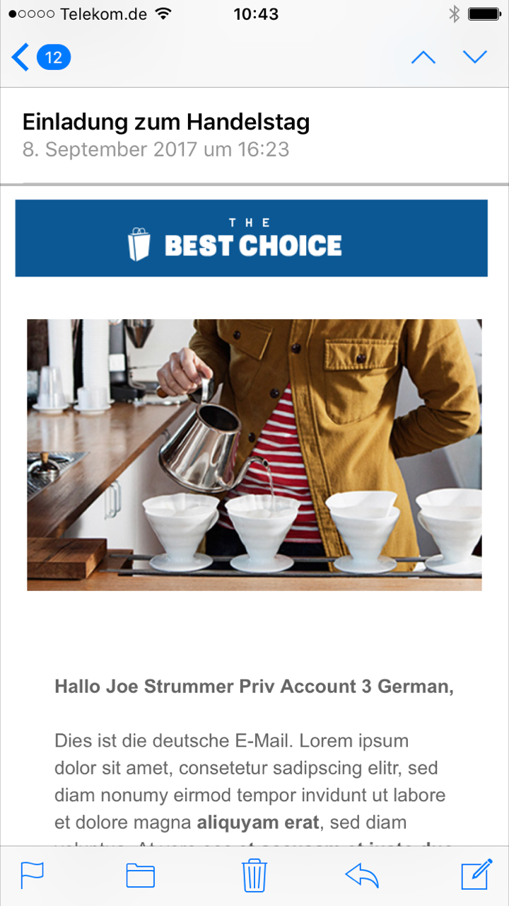
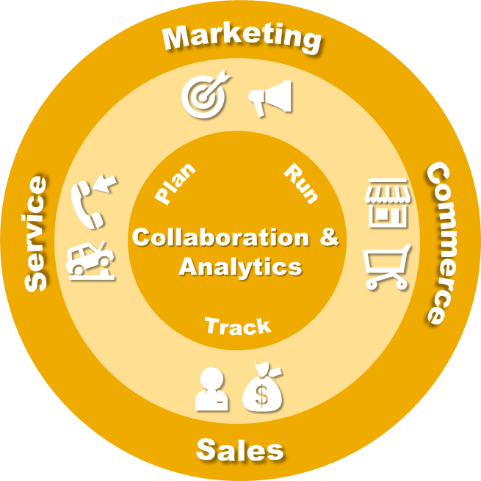
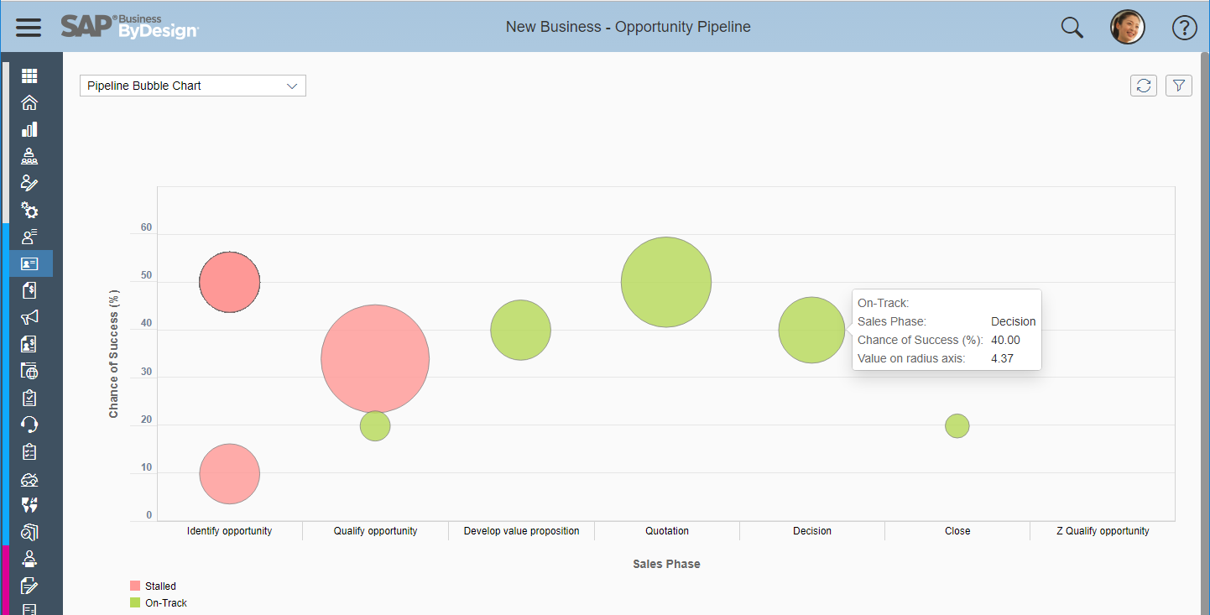
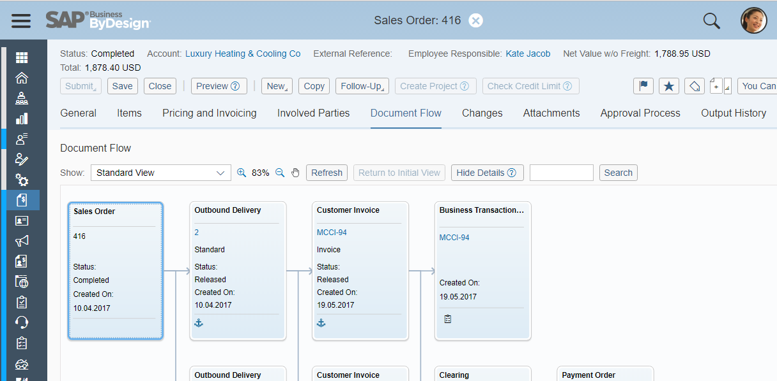
Overview of SAP Business ByDesign CRM
End-to-end customer engagement
Marketing & presales communication
Marketing communication
Activity & lead management
Mobile & groupware integration
Service execution
project-based & productized
Standard services
(e.g. facility management)
Field service & repair
In-house repair with customer returns
Execute marketing campaigns
Collaboration Invoicing
Analytics
Low-touch sales &
commerce integration
Short sales cycles / high volume of customers
Internet sell from stock & service (order)
Point-of-Sales
Over-the-counter sales
Track & manage sales from opportunity to order
High-touch sales
Long sales cycles / low volume of customers
Manual sell from stock for complex products
Manual selling service for e.g. projects or standardized services
Automate Order Creation & Execution

Slide 6

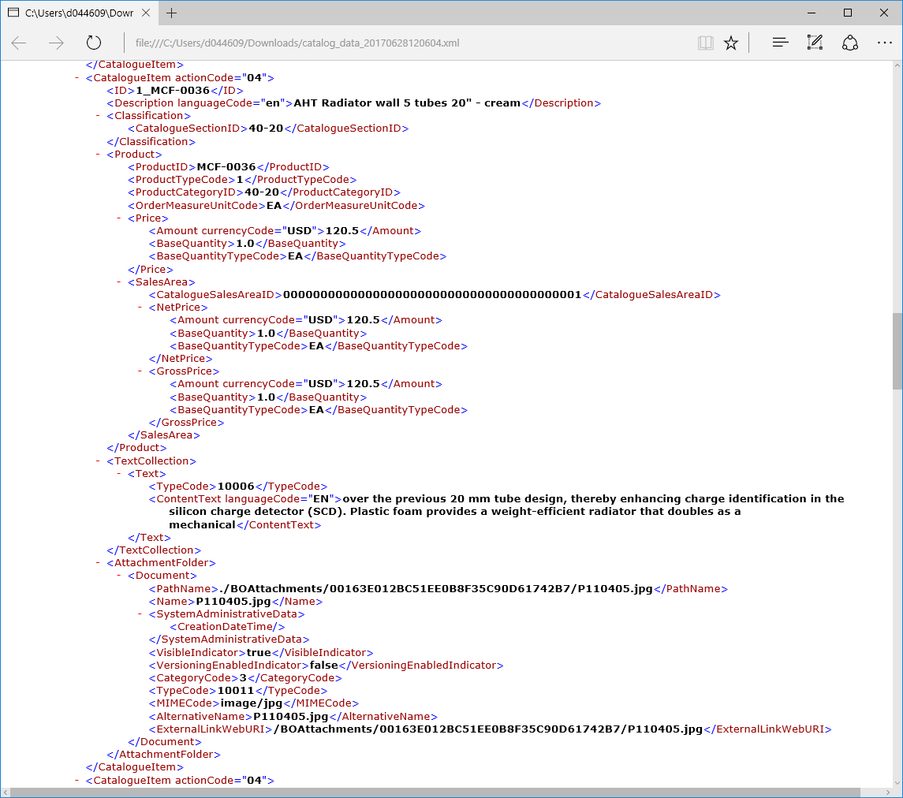
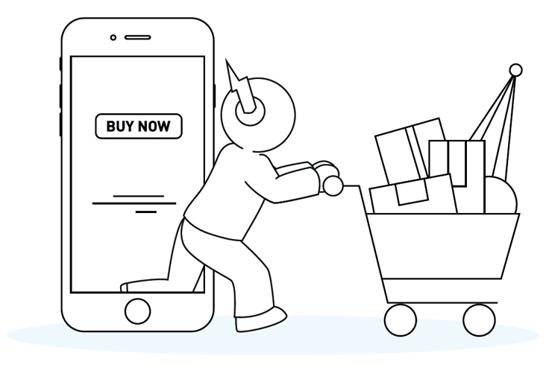
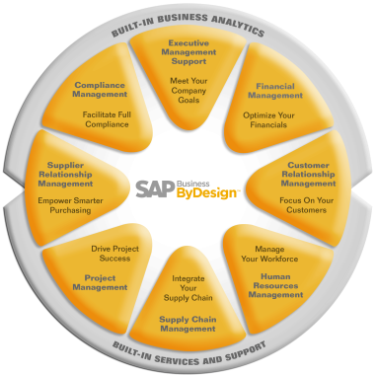
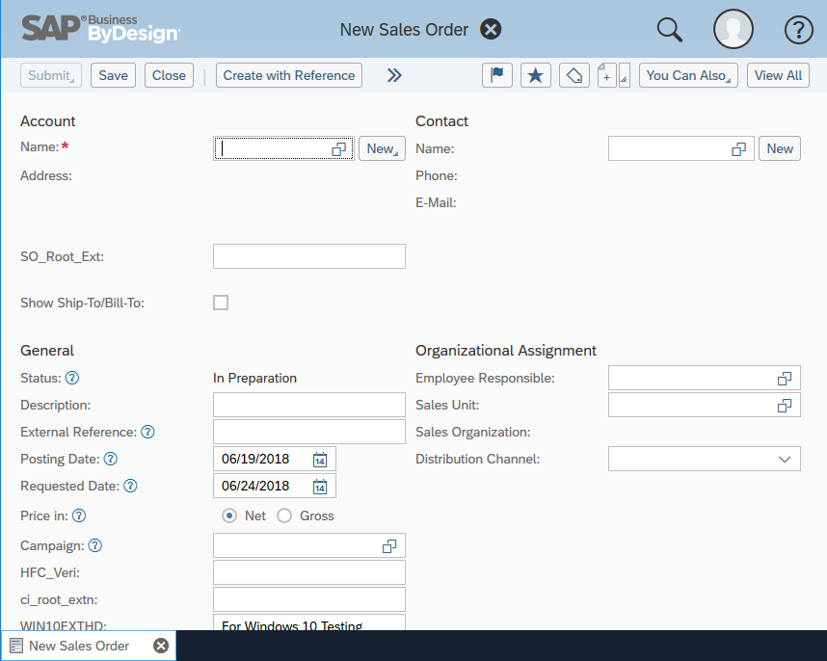
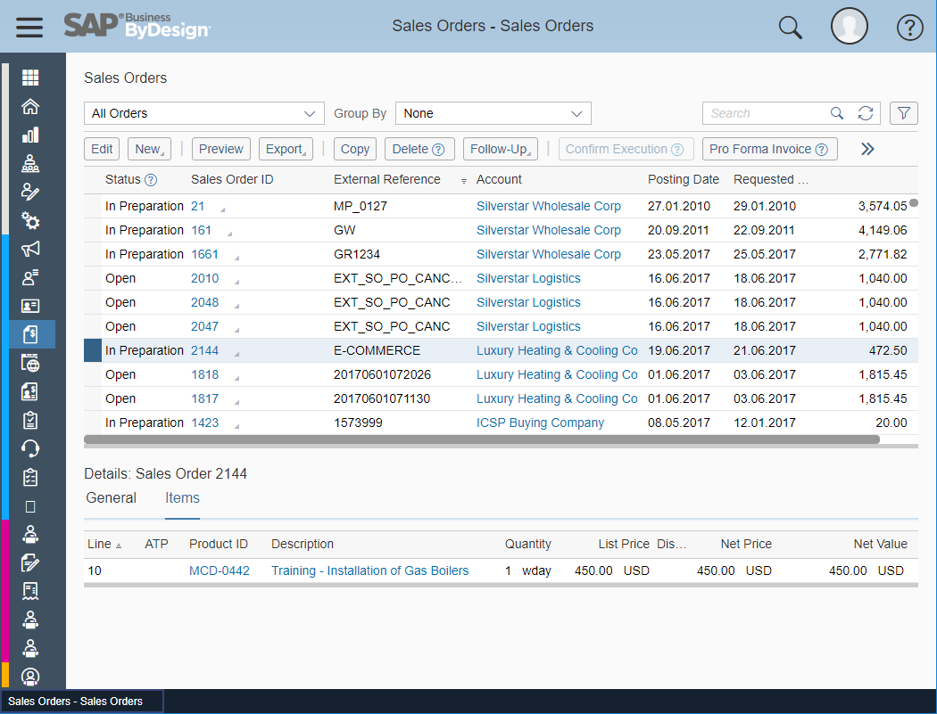
Customer Engagement and Commerce Integration
Extend your digital core in SAP Business ByDesign with any 3rd party marketing, sales, & service application
KEY MESSAGE
  More than 300 standard web services are provided with ByDesign and can be leveraged to integrate any kind of 3rd party software
  Customer OData services can be exposed using the OData workbench for more than 300 business objects
  Most common customer engaging scenarios like webshop or customer portal can be built using sales order, invoice, account etc.
  Integration can either be using a middleware like SAP CPI, as point-to-point or user interface mashup integration
e.g. Webshop, CPQ, Marketing Automation, Service Engagement, Customer Portal, Point-of-Sales
Standard
Web Services
3rd party marketing, sales, & service applications
Executing and invoicing customer requests
Order > Fulfillment > Invoicing
Credit Card Payment
Account & Contact
Activity, Lead, Opportunity
Service Requests
Product Catalog
Product Availability
Flexible Pricing
Sales Order, Invoicing & Tax
…more
Soap / OData
Most important standard interfaces:
Account
Lead
Activity
Opportunity
Sales Order
Service Request, Order & Confirmation
Customer Invoice
Product & Price Master Data
Product Availability Check (ATP)
Point-of-Sales Transaction
…more
User Interface Mashup
URL / HTML5

Slide 7





SAP Business ByDesign Commerce Add-on: Extend your business with a full service cloud webshop
KEY MESSAGE
  Cloud webshop with SAP Business ByDesign connection powered by ECENTA Digital
  Full service included: Implementation, optimization, operation and 24x7 support
  Customer Order Execution: Sales order execution, invoicing, availability check and more from SAP Business ByDesign
  Customer Self-Service: Contact forms, service requests and other self-services from SAP Business ByDesign
  Available for SAP Business ByDesign customers and partners as resell package
Commerce ^{by ECENTA DIGITAL}
Cloud ERP
B2B & B2C Webshop for 24x7 online business
Executing and invoicing customer requests
High performance consumer grade shopping experience
SAP Business ByDesign integration for customers, orders and more
2 hero banner, CI adaption
Data privacy management
…more
Setup & operation services
Implementation of custom web design
24x7 premium support
Controlling cockpit
Order > fulfillment > invoicing
Account management
Product catalog management
Product availability
Flexible pricing
Invoicing & tax
Service requests
Lead generation
Data privacy management
…more

Slide 8
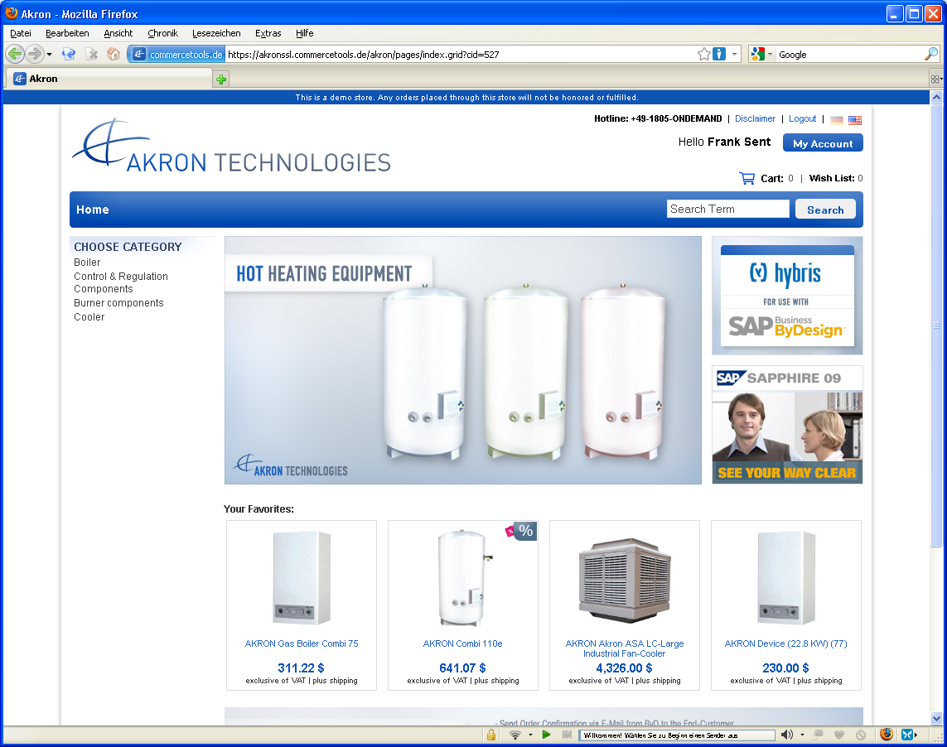
Webshop: Extend your business with B2B & B2C webshops
KEY MESSAGE
  Enhance E-Shops with sales order execution, invoicing, central availability check, customer specific pricing, account & product
  Integrate contact forms, service requests and other self-services to Business ByDesign
  Support B2B and B2C Scenarios with one powerful solution
  Connect any webshop with open ByDesign web services to support maximum flexibility
Webshop
e.g. Hybris Commerce
Consumer & Reseller Webshop for 24x7 online business
Executing and invoicing customer requests
Order > Fulfillment > Invoicing
Credit Card Payment
Account Management
Product Catalog Management
Product availability
Flexible Pricing
Invoicing & Tax
Service Requests
Lead Generation
…more
High performance consumer grade shopping experience
Flexible payment options
Search engine optimization (SEO)
…more
Standard
Webservices
Middleware

Slide 9
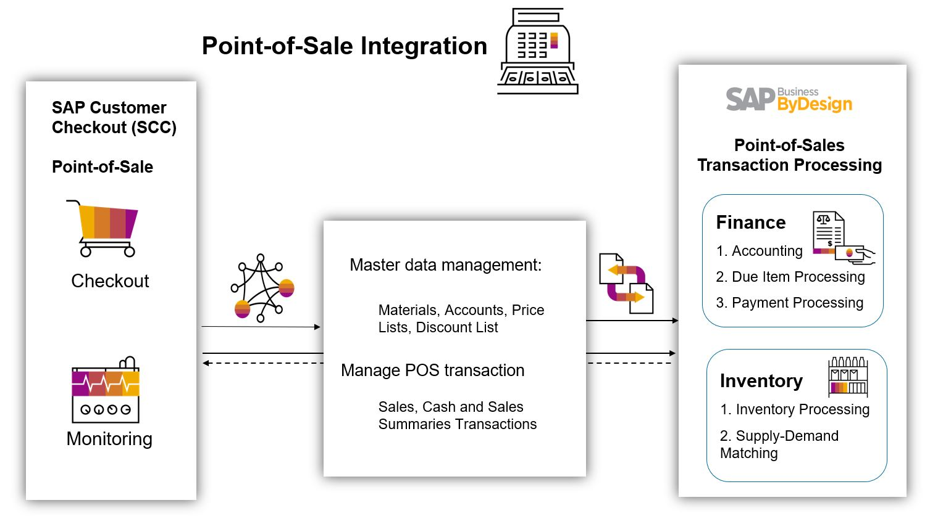
Selling to B2B and B2C customer in Point-of-Sale
User Story
Sales employees receive orders and assign service employees for execution including capturing of Alipay
Capabilities
Sales order capturing for standard service (e.g. cleaning, plumber, repair, facility service) including assignment of service employee
Execution of service using smartphone
Service confirmation with payment code capturing
Automatic Invoice creation
Benefits for customers
Simplify gathering of new prospects and contacts

Slide 10
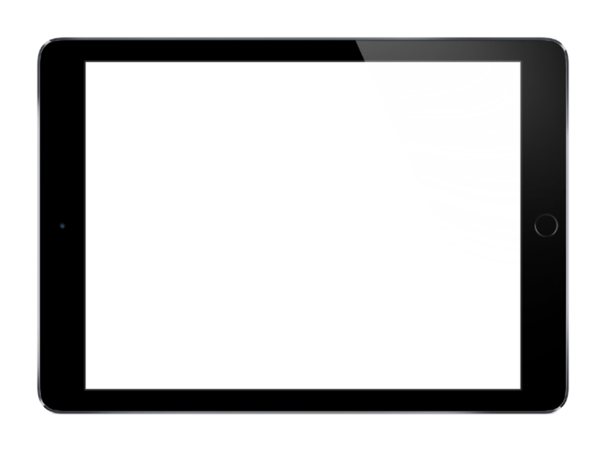
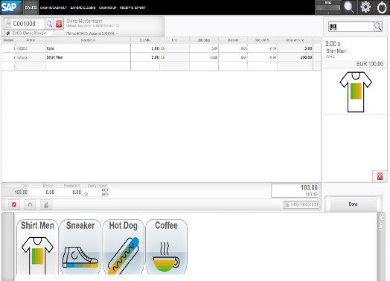
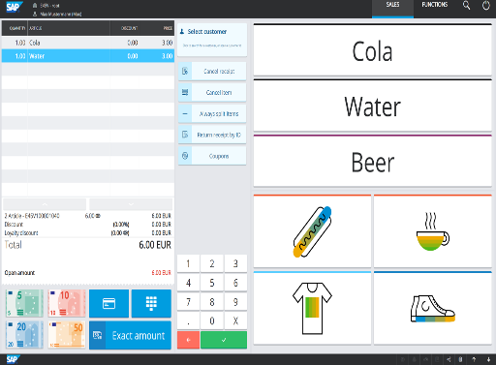
SAP Customer Checkout
Product Description
SAP Customer Checkout covers all common point of sale requirements needed in retail, merchandising, and catering. From sales to discount campaigns, SAP Customer Checkout offers all functionality cashiers and sales staff need.
SAP Customer Checkout offers tightly integration capability into SAP ERP systems (SAP Business One, SAP Business ByDesign and SAP ECC Retail).
Point of Sale functionality
  Article selection
  Price and tax calculation
  Point of Sale hardware integration
  Various Payment methods
  Returns
  Different UI modes tailored to your business (Retail, Kiosk, Hospitality)
  Day-end closing
  Loyalty management
Integration
  Master data download from SAP ERP Systems
  Sales receipt upload to SAP ERP Systems
Central management
  Central voucher, user, quickselection receipt management
  Central loyalty management
This presentation and SAP‘s strategy and possible future developments are subject to change and may be changed by SAP at any time for any reason without notice. This document is provided without a warranty of any kind, either express or implied, including but not limited to, the implied warranties of merchantability, fitness for a particular purpose, or non-infringement

Slide 11
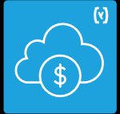
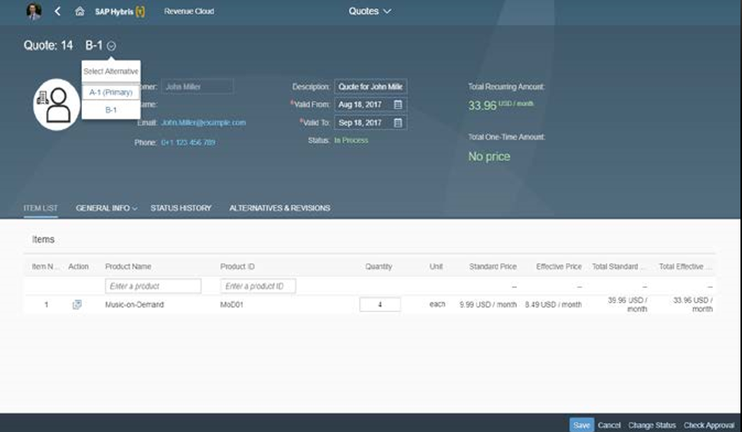
CPQ & Subscription-business: Configure, sell & measure services
KEY MESSAGE
  Out of the box integration for ByD and SAP Subscription Billing using SAP CloudPlatform Integration flows (SAP CPI)
  Support subscription-based business models by configuration of standard integration flows in SAP CPI
  Extend and adapt standard integration flows in SAP CPI
  Sample Scenario:
    SAP Subscription Billing: Configure Service, determine price, create order and measure usage
    SAP Business ByDesign: Receive invoice request using standard webservices and start invoicing.
SAP Subscription Billing
Customers
configuring & using complex products & services on subscription basis
Executing and invoicing customer requests
Order > Fulfillment > Invoicing
Credit Card Payment
Account Management
Product Catalog Management
Product availability
Flexible Pricing
Invoicing & Tax
Service Requests
Lead Generation
…more
Define subscription products and rate plan
Configure product & service
Subscription management
Rate usage and consolidate billing data
…more
SAP CPI
Extendable
Standard
Integration
Free trial for SAP Subscription Billing

Slide 12








Example: Custom integration for tangible & intangible services and products
Key Message
Extend the predefined SAP CPI integrations flows by using more available standard interfaces of ByDesign & SAP Subscription Billing
Intangible Services: Revenue Recognition is done outside ByD by invoice date, Profit only on invoice level. GL postings might be needed either manual or by financial notification
Tangible Products & Services: Integration for Sales Order & Product data might be needed to allow revenue
recognition on sales order, service confirmation & delivery, Profitability on sales order
Market: Intangible products without confirmation & delivery e.g. Postage, Lettershop, Software…
Intangible: Services
SAP Subscription Billing
Receive products (header)
Create & receive account
Configure order for service with pay per use
Measure usage of
service
Aggregate billable items
FIN: e.g. hourly, daily…
Tangible: Products & Services
(with execution confirmation & delivery)
create manual
uni-directional sync
create only
create only
Service Confirmation
Manage service & material
FIN: Consumed quantity
Create invoice request with aggregated items
Create & receive account
Create & Execute Order
Reference
FIN: Planned quantity,
RAC, POB, Profitability…
FIN: Consumed quantity
Market: Service & Material with service execution & delivery e.g. Onsite Print machine incl. consumables
Outbound Delivery

Slide 13
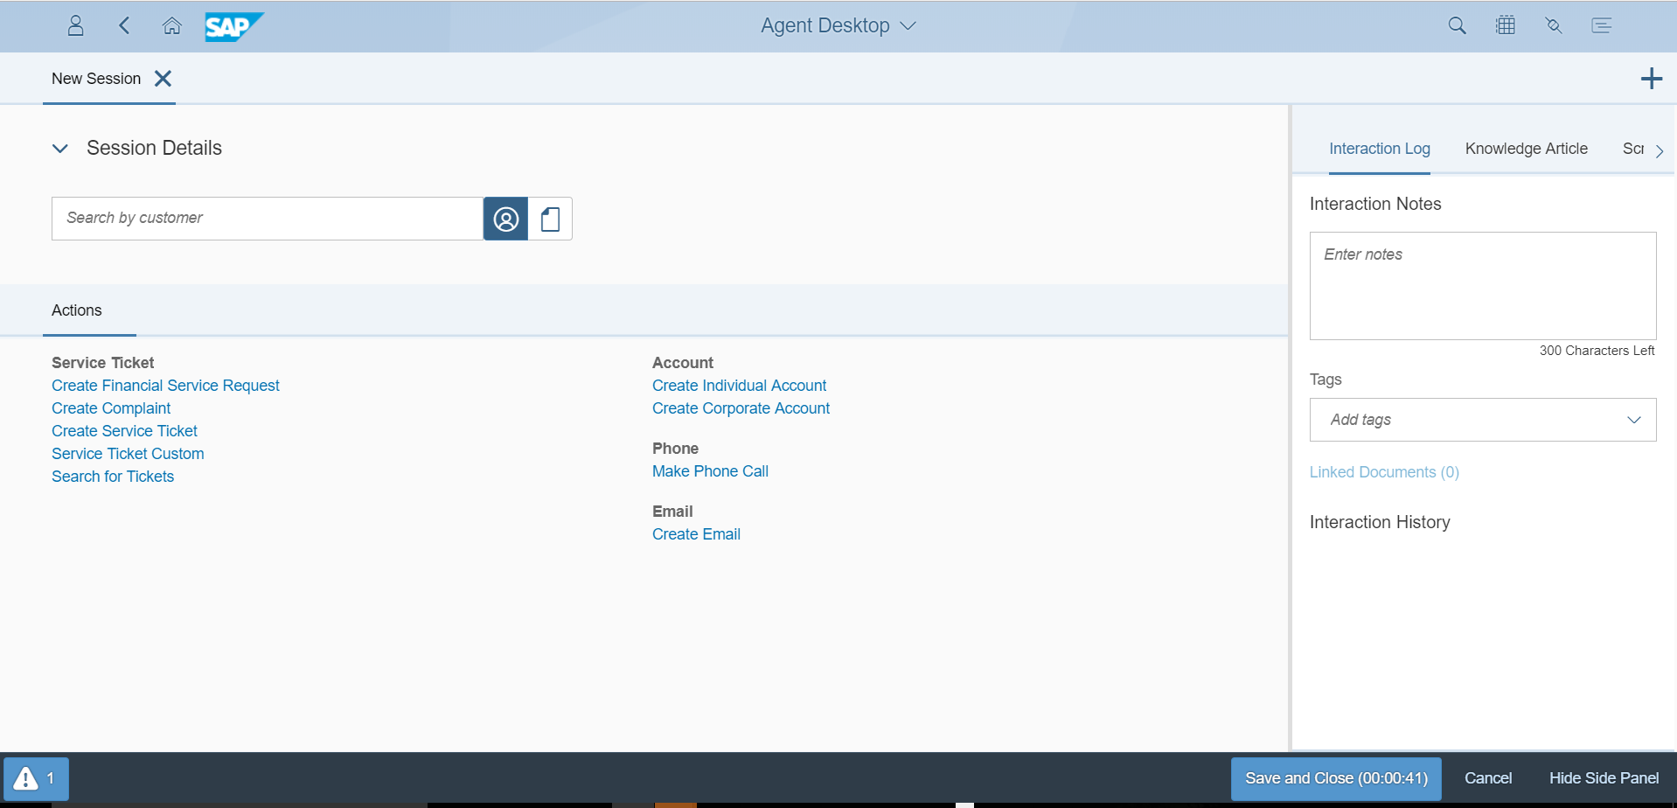
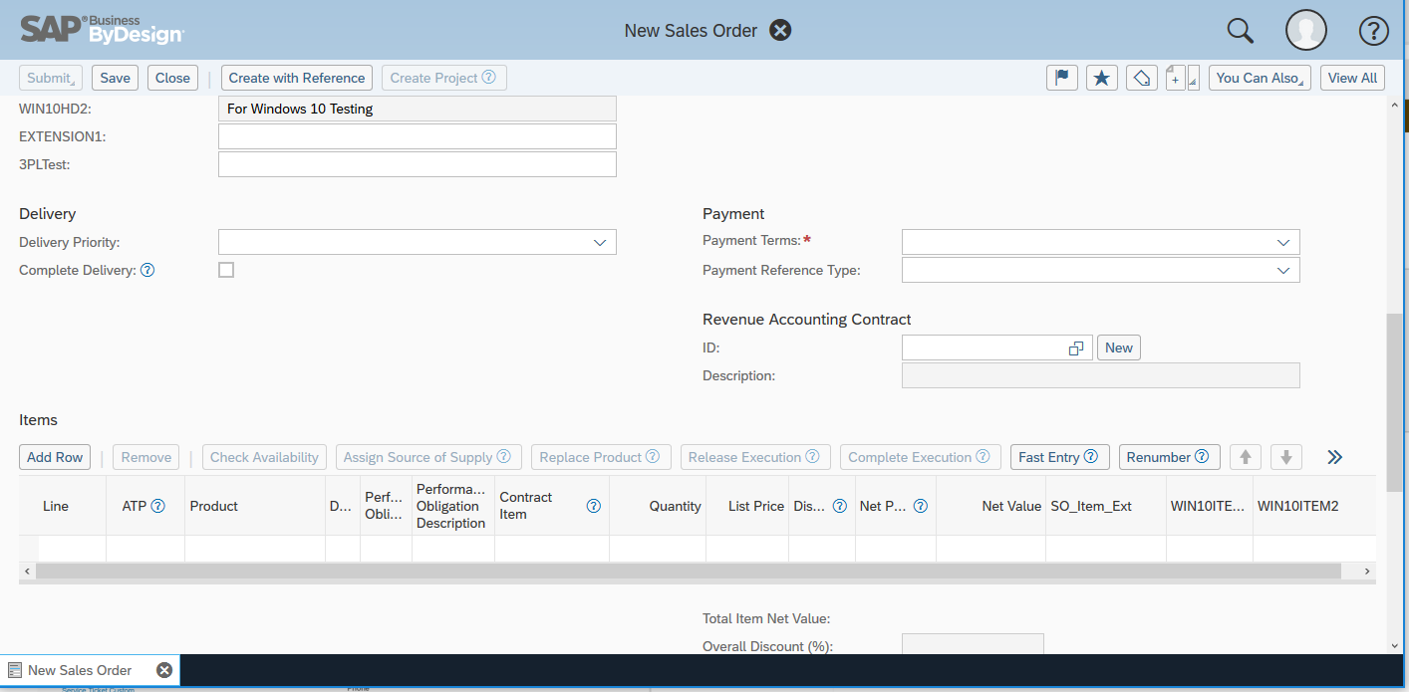
Customer Engagement and Commerce Integration
User Interface mashups with SAP Business ByDesign
User Story
  System integrators want to mashup ByD user interfaces with 3rd party applications
Example Steps
  Design basic integration backend integration e.g. account & contact data replication
  Design user interface mashups using external object-based navigation enables e.g. show ByD sales order, account factsheet
  Launch ByD transactions and analytical reports
Backend
Integration
Mashup
Integration
EXAMPLE OBN URL for sales order creation: https://myxxxxx.vlab.sapbydesign.com/sap/public/ap/ui/repository/SAP_UI/HTMLOBERON5/client.html?bo_ns=http://sap.com/xi/AP/CRM/Global&bo=SalesOrder&node=Root&operation=Create&object_key=&key_type=APC_S_BTD_ID&OBNRedirect=X

Slide 14
Customer Engagement & Commerce Integration details

Slide 15
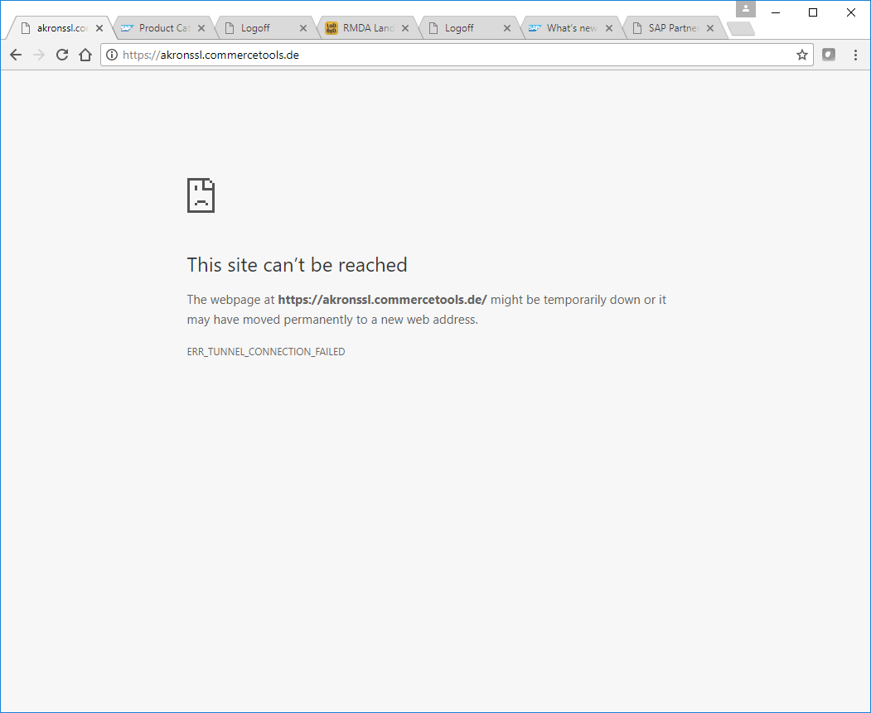





Examples – SAP ByDesign Commerce Integration
Commerce

Slide 16
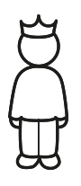
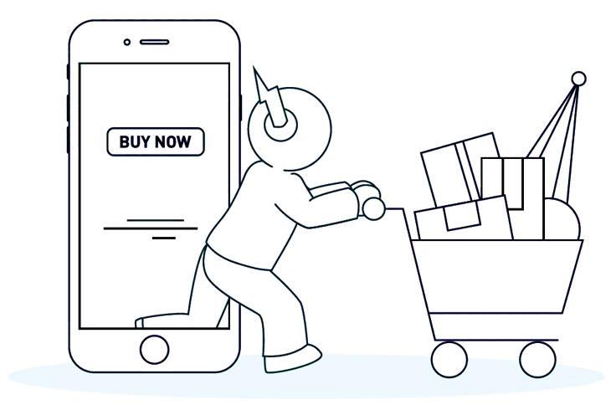

Example: Basic webshop integration
Buyer
Webshop
Backend
User Story
Consumers shall be able to buy a product in the webshop and all master data and the order execution is handled by ByDesign
Integration steps
Initial load and bi-directional sync account & contact
Initial load product catalog with price and periodically pull delta from ByD
Add and enhance marketing product data in (e.g. text, image, video)
Create Sales Order in ByD and consume ATP, price & tax from ByD
Payment authorization & settlement by payment provider
Periodically retrieve order fulfillment data from ByD and display in webshop.
Benefits for customers
Powerful and flexible commerce integration to any webshop
Login / Registration
User Account
Management
Sync accounts
Account Mgmt
Publish and Verify
1
Shopping
Inventory Check,
Price, Tax, Shipping
Buy
Checkout
(after login)
Create Sales Order
4
Confirmation
Order Fulfillment
Payment Provider
Payment Authorization
Payment Settlement
5
Self-Service
Order History
And Status
Retrieve Order History
And Status
6
Product Catalog
Product Catalog with
base price
2

Slide 17
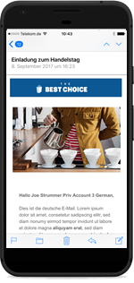
Example: Webshop integration for campaign specific pricing & tracking
Customer
Webshop
Backend
User Story
Consumers shall be able to receive campaigns from ByDesign and buy products in the webshop and receive discounts from ByDesign campaigns
Integration steps
Initial load and bi-directional sync account & contact between ByD and webshop
Execute direct mail campaign from ByD with link to the webshop which includes campaign reference as link
Optionally assign a campaign specific discount list to the campaign.
Create Sales Order in ByD and consume campaign specific price & tax from ByD
Analyze campaign success with the standard reports including number of and revenue of orders
Benefits for customers
Powerful and flexible marketing execution integration
Register
User & account
Management
Synchronize
Account & contact
Management
1
Direct mail execution with campaign ID (manually added ID in mail template)
Create Campaign
2
Assign campaign
discount list
Shopping
(with campaign reference)
3
URL with campaign ID parameter
https://.../?pk_campaign=1234
Buy
Checkout
(with campaign reference)
Campaign ID
Create Sales Order
with campaign reference
Campaign specific price
4
Campaign success
with order volume
5

Slide 18

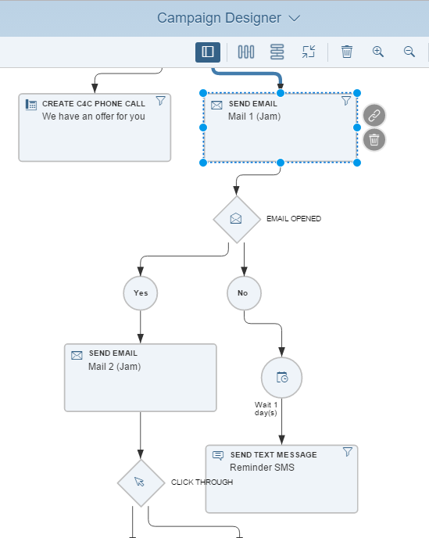
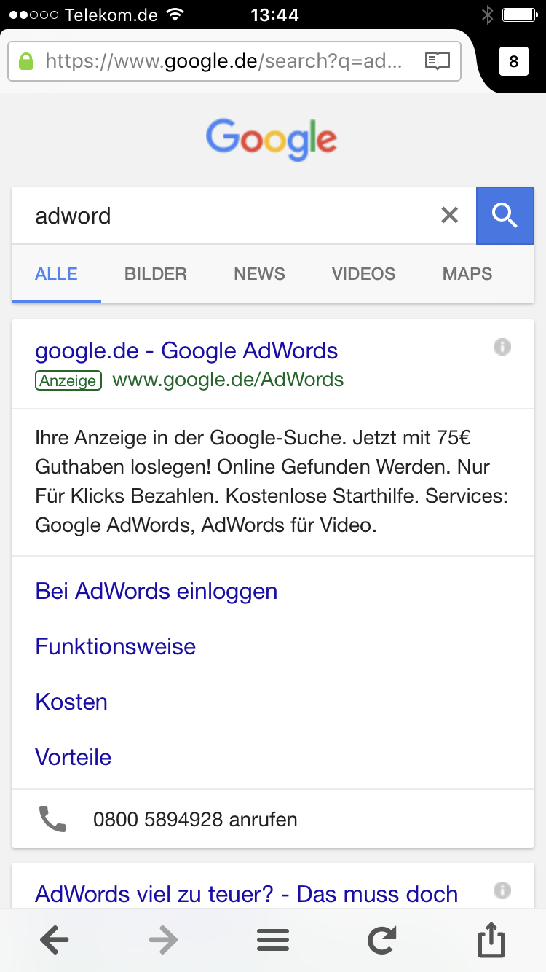
Example: Marketing automation integration for external campaign execution and follow-up activities in ByDesign
Customer
Marketing
Automation
Backend
User Story
Consumers shall be able to receive campaigns from an external marketing automation solution which is integrated to ByDesign for follow-up sales
Integration steps
Initial load and bi-directional sync account & contact between ByD and marketing automation
Design and execute multistep and channel campaigns and track all customer interactions
Directly trigger follow-up activities for sales employees in ByDesign from the campaign automation
Aggregate and rate responses before lead is created
Benefits for customers
Best of breed marketing automation for any marketing channel integrated to ByDesign as sales backend
Register e.g. by
landing page
Account & contact
Management
Synchronize
Account & contact
Management
1
Campaign Automation
Multi channel campaign execution
2
3
e.g. click on mail link
Open Channel:
e.g. create activity
if product = XY
Create Activity for
sales follow-up
e.g. Adword click
Lead Scoring
if score > XY
Create Lead for
sales follow-up
4
Create Sales Order
with campaign reference

Slide 19
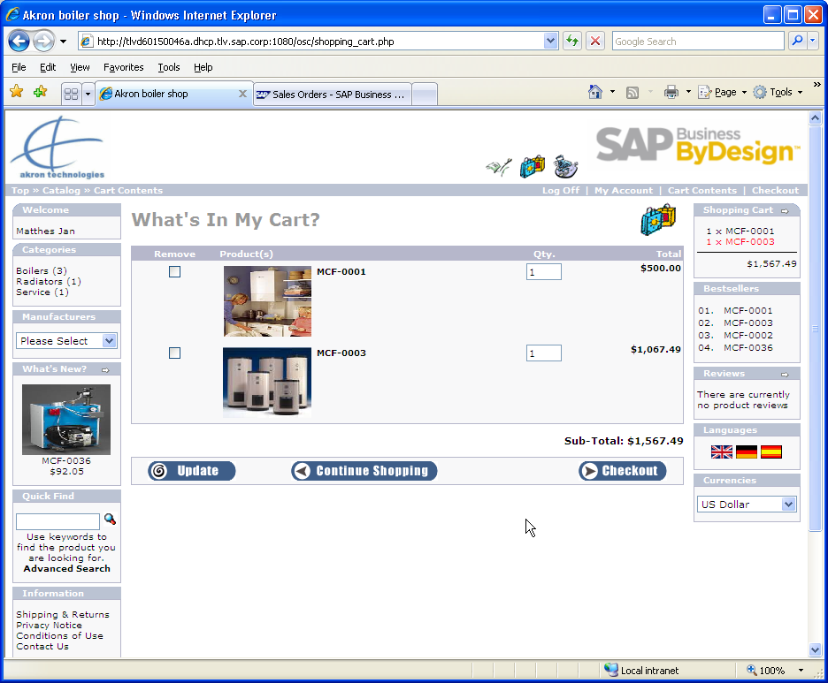
Sales Order real time calls
User Story
Consumers shall be able to get availability, price, tax and order execution information directly from ByDesign
Capabilities
During check-out real-time data is provided for:
  Price incl. customer specific prices & discounts
  Product availability (ATP)
  Shipping rate
  Taxes
After checkout a sales order will be created automatically and executed in ByDesign
New orders can be also buffered in the shop and transmitted periodically
Prices and product availability can also be periodically exported from ByDesign to the webshop
Price in orders can be overwritten by the webshop
Benefits for customers
Real-time order processing with product availability, price and tax calculation
Webshop
4
Browse product catalog
Checkout
1
Account & Order
Tax
Product Catalog
Price
Advanced Prices
Product availability
Product availability

Slide 20
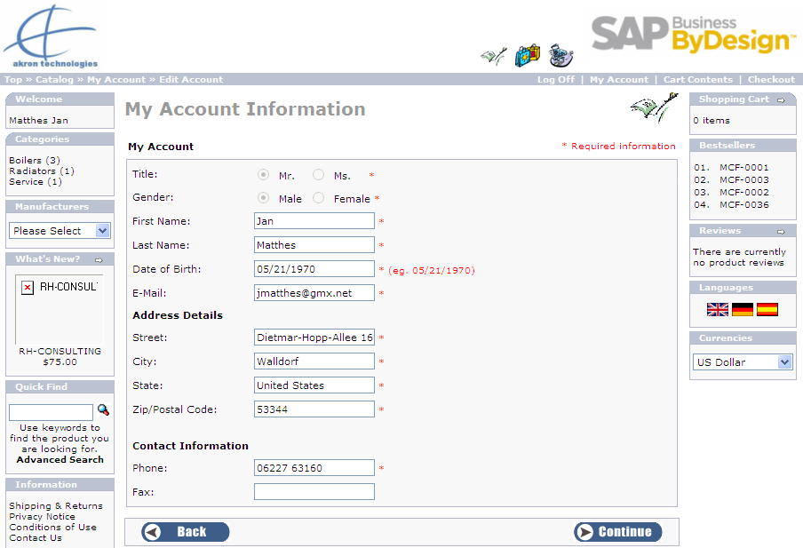
Account Synchronization
User Story
Consumer master data needs to be created and synchronized on both sides - the webshop & ByDesign
Integration steps
Accounts & contacts are created automatically in ByD after initial registration in webshop
Existing accounts will be updated automatically
Alternatively updates can be exchanged periodically
User accounts and passwords should reside only in the webshop to make change simple
Benefits for customers
Flexible synchronization of accounts and contacts
Webshop
Browse product catalog
Checkout
Create Account
Update existing
1

Slide 21
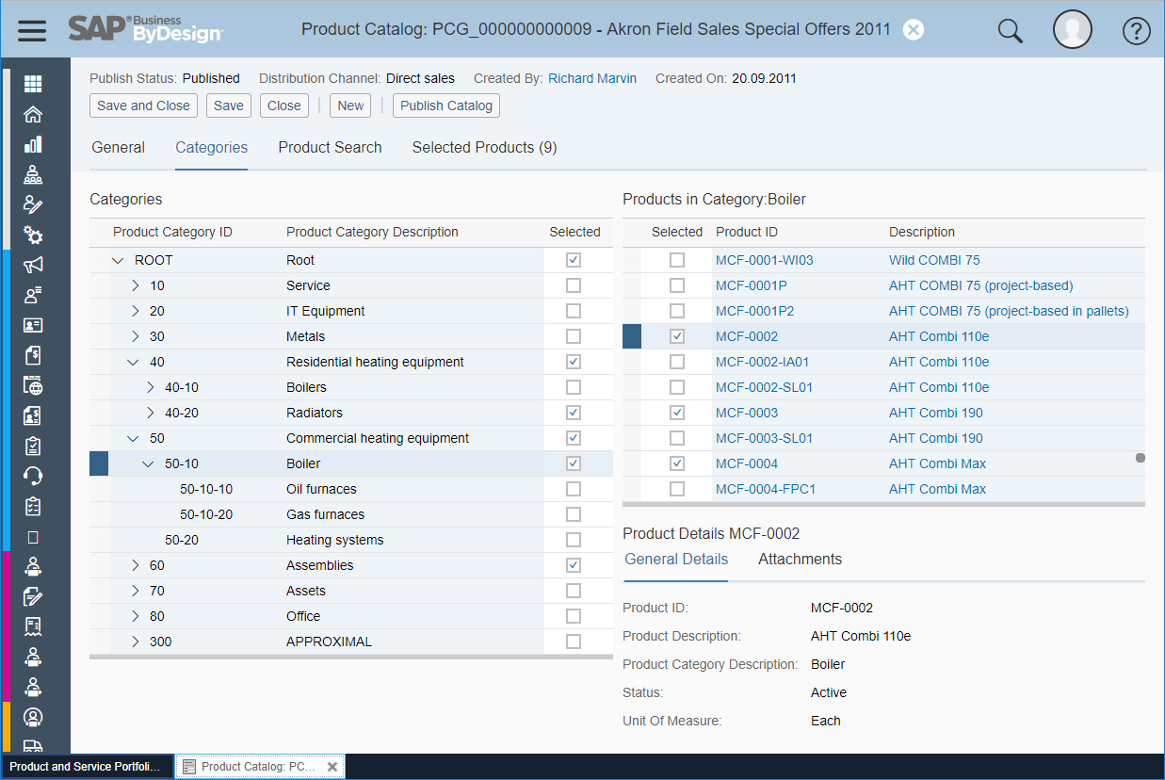
Product Catalog
User Story
Webshop administrators are enabled to initially and periodically load product catalogs from ByDesign to the webshop
Capabilities
Product Catalog provides a collection of products and services
The catalog is a subset of the product master data including the associated hierarchy
Net and gross prices are part of the catalog
Selection of distribution channel and sales organization allow to have specific prices for each channel.
Additional data for a product can be retrieved by a specific webservices (e.g. material details, price, ATP)
Benefits for customers
Easy & flexible synchronization of products with base prices

Slide 22
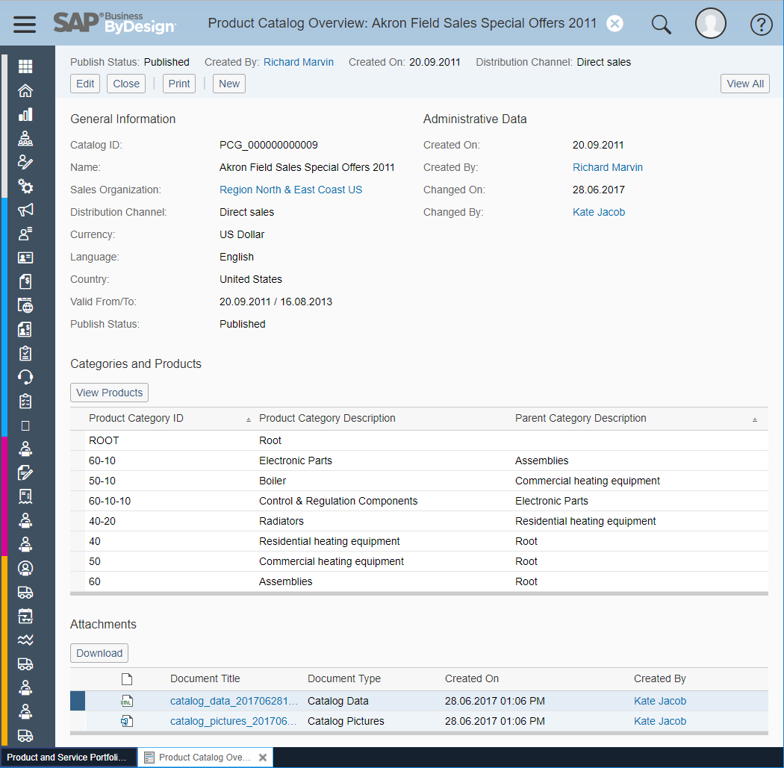
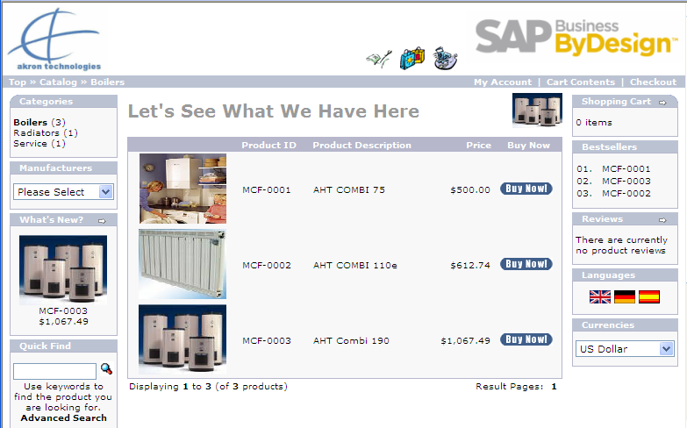
Product Catalog
User Story
Webshop administrators are enabled to initially and periodically load product catalogs from ByDesign to the webshop
Capabilities
Create multiple catalogs with name, description and person responsible in Product and Services Portfolio work center
Export catalog information to an xml file. The catalogs can be exported (as an action) for import to the web site
Different catalogs could be utilized for different sales channels or regions.
Automatically retrieve the product catalog with a Web Service call
Benefits for customers
Easy & flexible synchronization of products with base prices

Slide 23
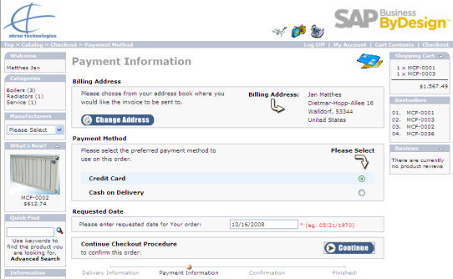
Payment Cards
User Story
Consumers can use payment cards with secure handling of sensitive card data
Capabilities
Authorization is done by Webshop and settlement is done by ByD.
The payment provider uses interfaces to both systems
ByD does not store confidential payment data (PCI compliant tokens).
Alternatively the payment method External Payment allows that the sales order will be externally settled e.g. by PayPal.
Benefits for customers
Direct and secure payment integration
Authorization
Webshop
Payment Provider
Settlement
Confirmation

Slide 24
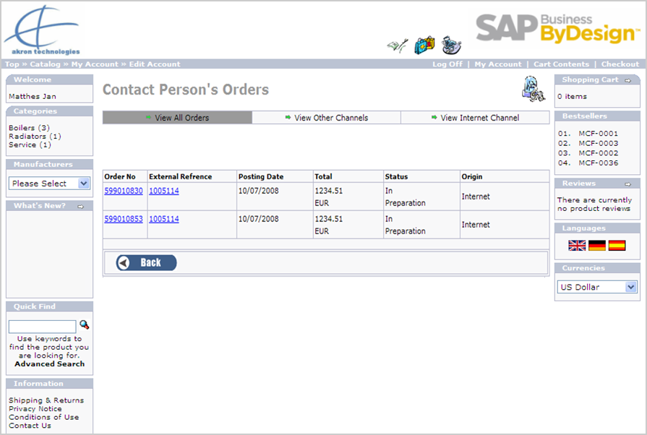
Self Service
User Story
Consumers can use self-services to place request which will be executed in ByDesign
Capabilities
Modify account details (e.g. add & change ship-to addresses in the webshop and ByDesign)
View all orders in the webshop. Drill-down to a specific orders. – Information is taken directly from ByDesign
Change orders prior to execution of delivery
Create leads, activities or service request and follow up on status
Benefits for customers
Direct collaboration for e.g.
after-sales service

Slide 25
Overview on interfaces & web services
All Integration Scenarios: https://help.sap.com/http.svc/rc/saphelp_byd1808_en/2018.08/en-US/PUBLISHING/IntegrationScenarios.html
E-Commerce: https://help.sap.com/http.svc/rc/saphelp_byd1808_en/2018.08/en-US/PUBLISHING/IntegrationScenarios.html#ECommerceWebShopIntegration
All Web Services: https://help.sap.com/doc/saphelp_byd1808_en/2018.08/en-US/PUBLISHING/IntegrationServices.html
Key Message
Build your own application on top of ByD A2X Web Services
Capabilities
Create, Query, Read & Update data in ByDesign.
Integrate ByDesign Webservices (A2X) to any webservice enabled 3rd Party software solution e.g. Webshops, Customer Portals, Excel
Services to read code values and lists
Service to retrieve analytical key figures and characteristics
Benefits for customers
Direct collaboration for e.g.
after-sales service
Main Business Object / Capability | Web Service Operations (A2X) | Example Scenarios | Example Use Case
Sales Order | Create, Read, Update, List | E-Commerce | Create & update sales orders in a Webshop
Account | Create, Read, Update | E-Commerce | Register & update Account in a Webshop
Lead | Mass Create | Migration, Excel Upload, E-Commerce | Contact form on a Website, Upload large number of leads
Activity : Task / Letter / Phone / Fax / E-Mail / Appointment | Mass Create | Groupware, Migration, Excel Integration | Create activities from Call Center or Website; Upload large number of activities via Excel
Service Request | Create, Read | E-Commerce, Mobile Service | Service Request form on a Website
Service Order | Read, Read related documents, List | Customer Portal Mobile Service | Read all Service Order related data on a mobile device
Service Confirmation | Create, Read, Update, List | Mobile Service | Create & Update Service Confirmations on a mobile device
Manual Invoice | Create (no A2X Service, only asynchronous) | Online Ticketing Application | Invoice Upload
Opportunity | Mass Create; Query | Mobile Sales | Create & Search Opportunities; Excel Upload
Campaign | Query | Webshop, Customer Portal | Read list of available campaigns and refer to it in follow-up objects
Products & Services inc. Product Category | Create, Read, Update | Migration Webshop, External Configurator | Maintain Products in the Webshop & update the data in ByD
Material | Query | Webshop, Customer Portal | Export list of materials (no services) to Webshop
Code lists (Webservice) | Query | All scenarios | Retrieve possible code values for list fields using QueryCodeListIn webservice
Analytics (OData Service) | Query | All data sources and reports | OData for Analytics allows to query, read and analyze ByD/C4C business data.
Calculate price | Read | All scenarios | Calcutates Price , Discount, Surcharge, Freight information of a given 'Product‘ for e.g. a certain account (CalculatePriceIn)

Slide 26

Integration related work centers
Application &
User Mgmt
Communication
Arrangements
Account
Management
New
Business
Sales
Orders
Marketing
Product and
Service
Portfolio
Service
Desk
Service
Orders
Field
Service
and Repair
Service
Entitlements
Customer
Invoicing
Managing
my Area
E-Commerce
Overview
Overview
Overview
Overview
Overview
Overview
Overview
Overview
Overview
Overview
Overview
Internet Order
Deletion Run
Accounts
Sales Orders
Leads
Products
Service
Requests
Registered
Products
Project
Invoicing
Accounts
Leads
Sales
Orders
Leads
Service
Requests
Service Order
Processing
Order
Pipeline
Approvals
Contacts
Opportunities
Market
Information
Services
My
Department
Partners
Sales
Quotes
Customer
Contracts
Pricing
Knowledge
Base
Service
Confirmations
Warranties
Items to be
Invoiced
Activities
Competitors
Product
Specifications
Service
Levels
Key
Performance
Indicators
Returns
Competitor
Products
Invoices
and
Credit Memos
Product
Catalog
Service
Categories
Product
Catalog
Target
Groups
Invoice Runs
Customer
Contracts
Payment
Authorization
Run
Campaigns
Reports
Reports
Reports
Reports
Reports
Reports
Reports
Reports
Reports
Reports
Reports
Reports

Slide 27
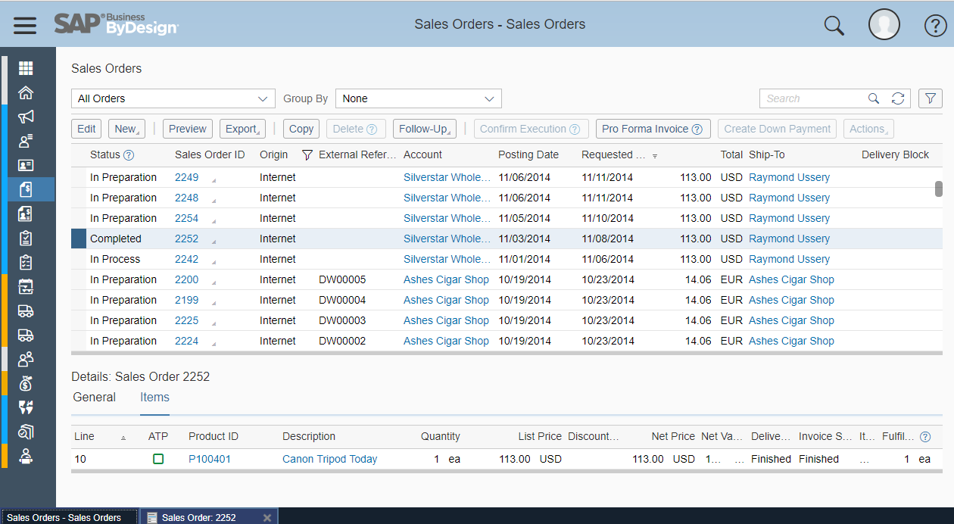
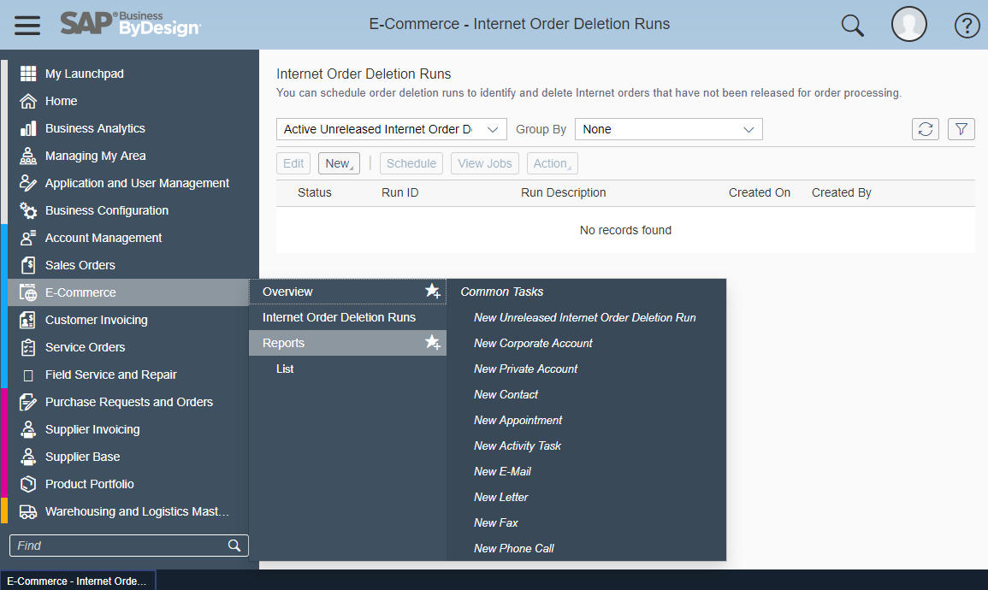
Integration related work centers
1
User Story
Sales employees are enabled to manage accounts and orders coming from the webshop.
Capabilities
Accounts can be established from an external web site and automatically created
Sales orders from the E-Shop are created and validated in the Sales Order work center
E-Commerce: Sales Order Deletion Runs allow to run batch job to delete all unneeded, unreleased sales orders created by E-Shop
Product Catalogs are also established and managed from the Product and Service Portfolio work center
Benefits for customers
One user interface and process for all sales channels
Account Management
2
Sales Orders
3
E-Commerce

Slide 28
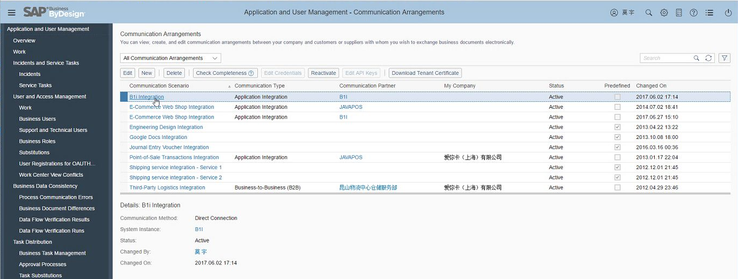
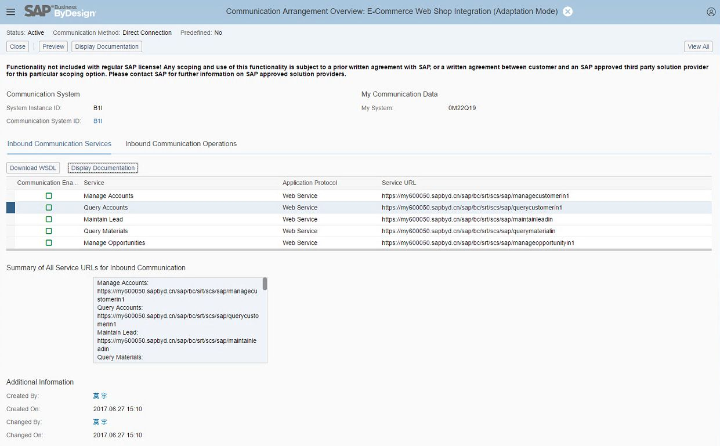
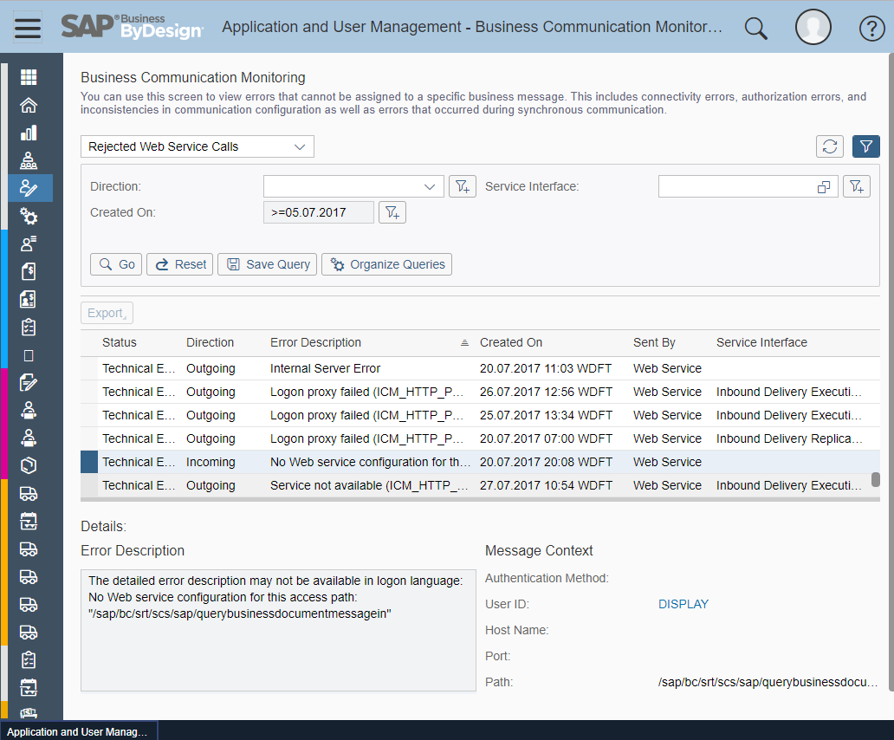
Application & User Mgmt Work Center
User Story
Administrators can define and control the access from external systems by integration scenario
Capabilities
Communication scenarios and arrangements allow to control external access (via the Application & User Management work center).
Valid certificates are required to allow access ByDesign Web services e.g. from the webshop
The certificate can be assigned to the technical user “_SAP_ECM” by using the “Edit Account” Action.
The same certificate can be used for multiple webshops integrated with the same tenant
Communication Monitoring e.g. for rejected web service calls
Benefits for customers
Secure and powerful management of web service interfaces

Slide 29
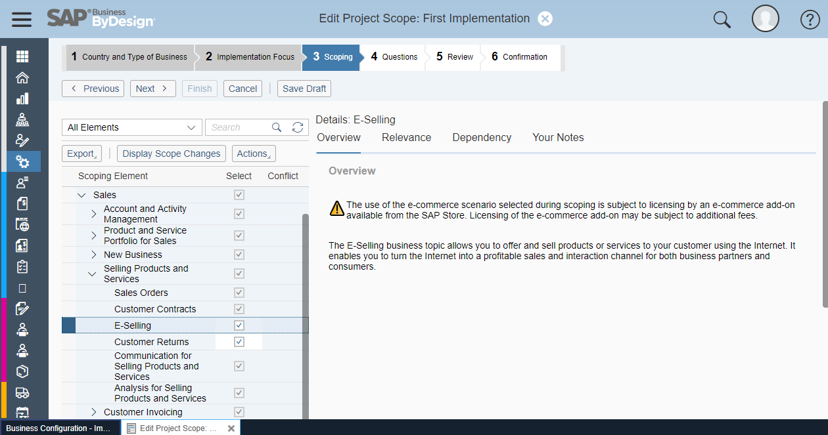
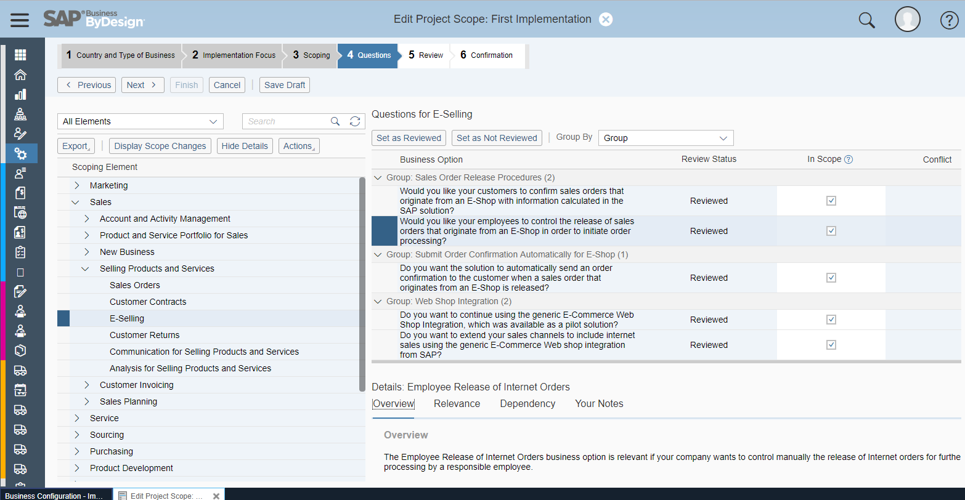
Business Configuration
User Story
Administrators can configure the commerce scenario using the business configuration
Capabilities
The E-Commerce configuration can be found in: Sales / Selling Products and Services
E-Selling related business questions can be found in:
  Business Area: Sales
  Business Package: Selling Products and Services
  Business Topic: E-Selling
There are no fine tuning capabilities related to E-Commerce
Benefits for customers
Adaptation of the commerce business scenario

Slide 30
Thank you.

