Slide 1


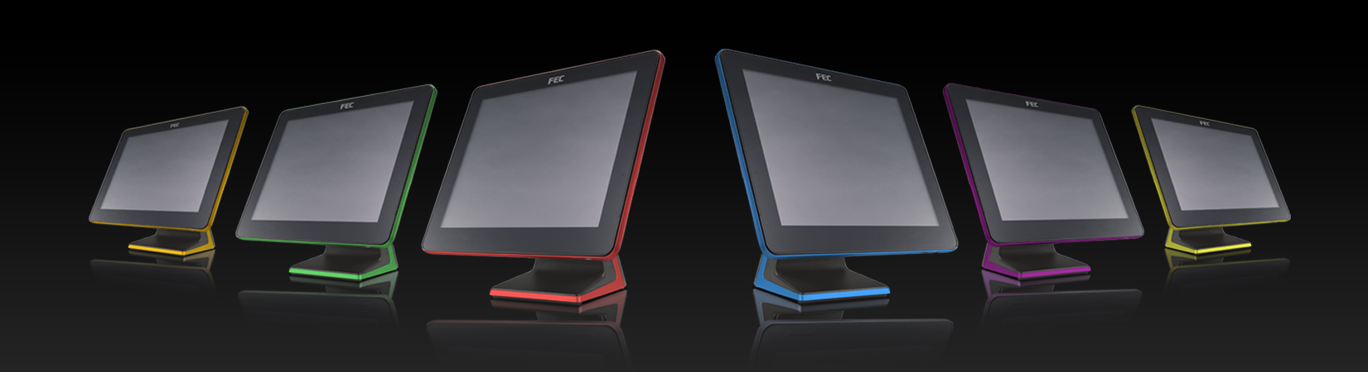
ELEVATE YOUR BUSINESS

Slide 2
22” Panel PC PP-8632
Product Introduction
2016.05.25

Slide 3
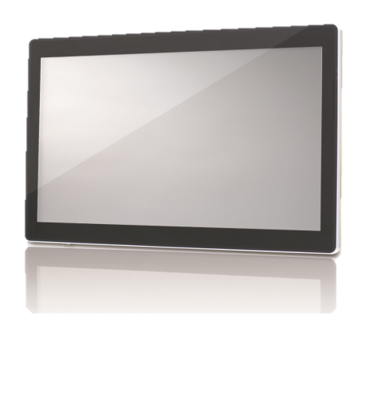
Product Features
All in one solution
P-CAP with 10 points touch
Slim design
Ease of use

Slide 4
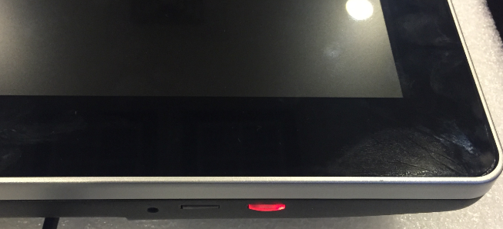
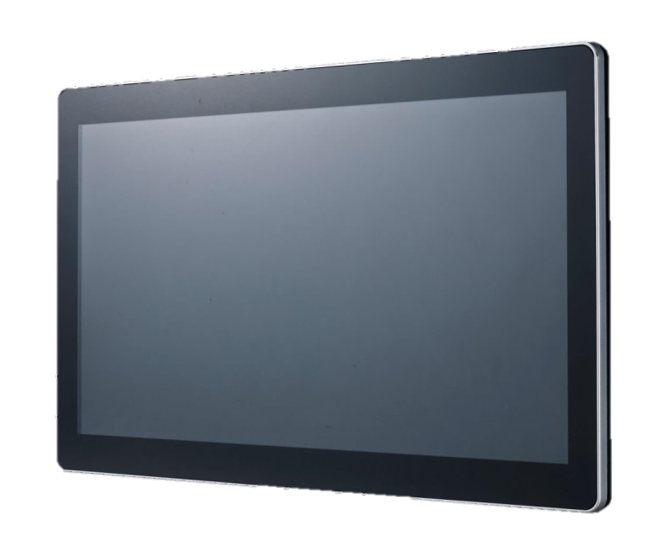
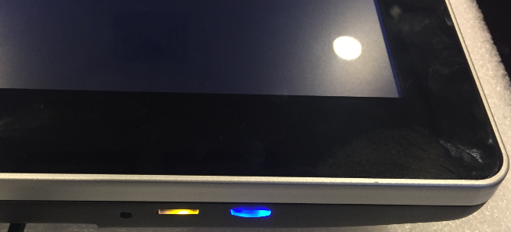
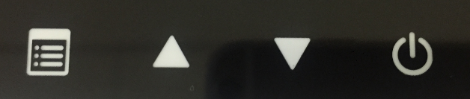
Power Switch
System power
Power off (Red)
Power on (Blue)

Slide 5


Dimensions
49 mm
530 mm
338 mm

Slide 6
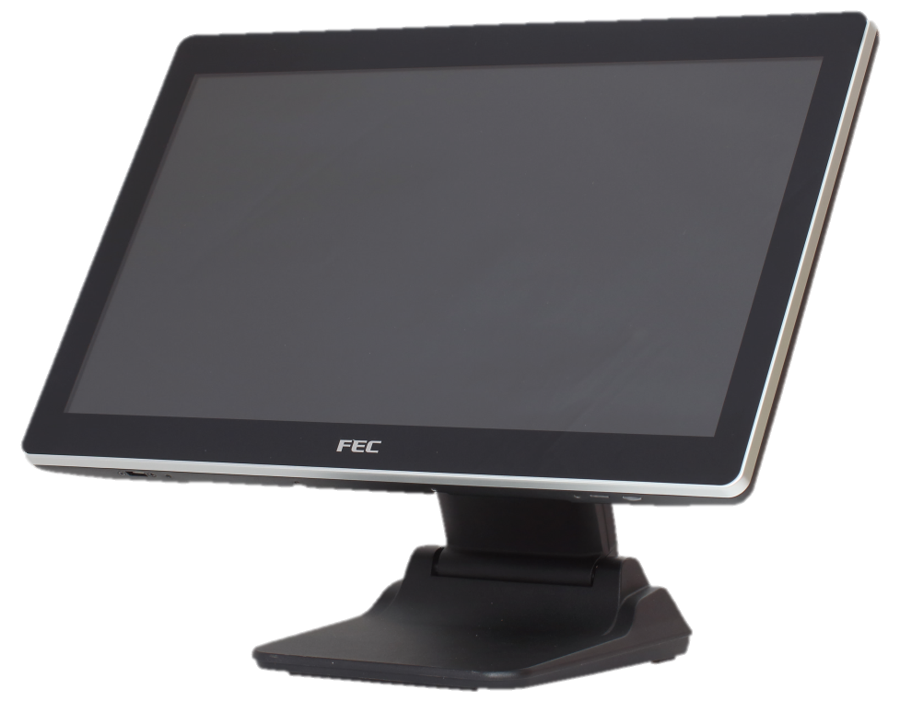
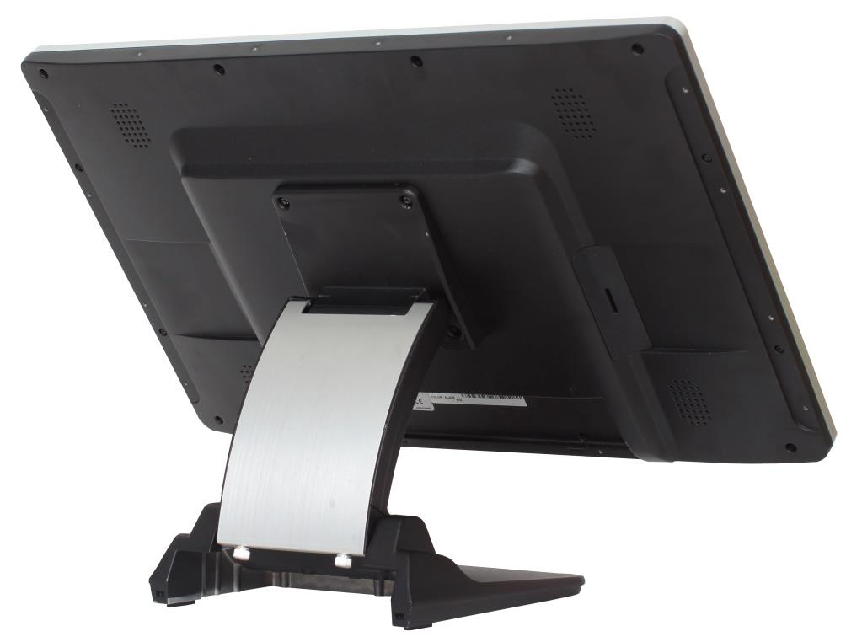
VESA Mount with stand
395 mm
220 mm
220 mm
It is easily setup on desktop with FEC stand

Slide 7
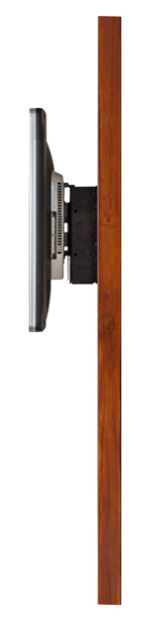
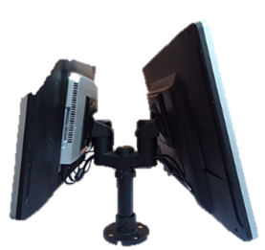

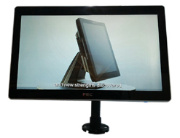
VESA Mount
Wall Mount
Dual-pole
Pole Type
With wall mount kits or pole, they can be mounted any flat surface.

Slide 8
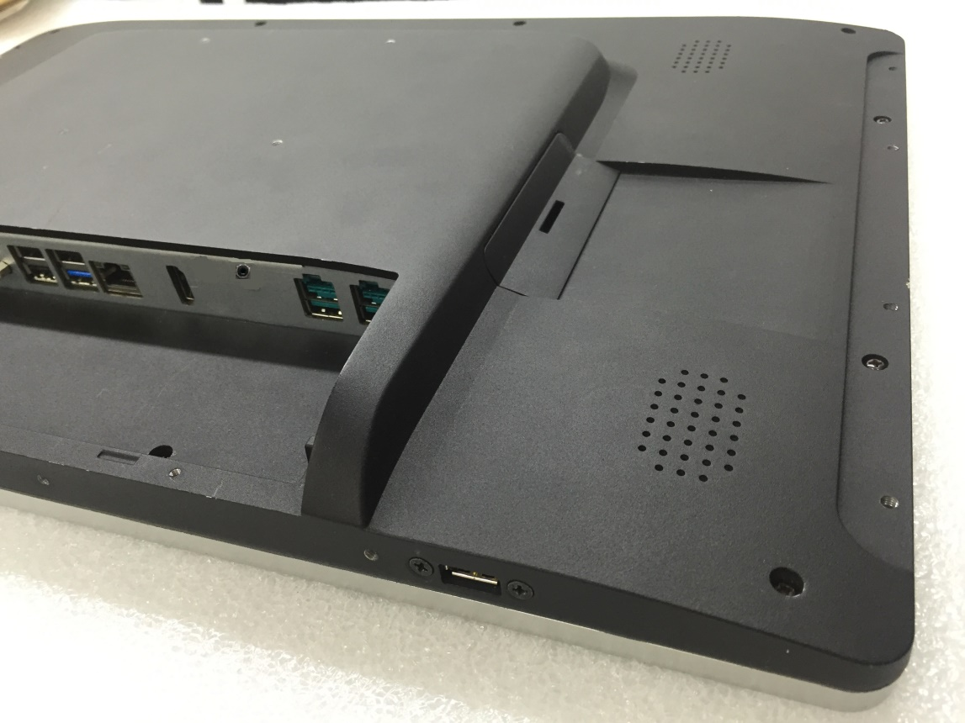
Panel Mount
Back holes on short side
Edge holes on long side
75
mm
100
mm
75
mm
100 mm
Panel mount allows kiosk or signage application.

Slide 9
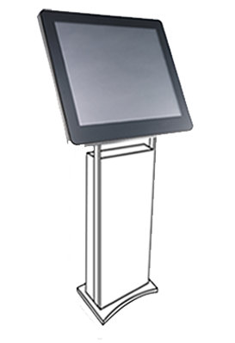
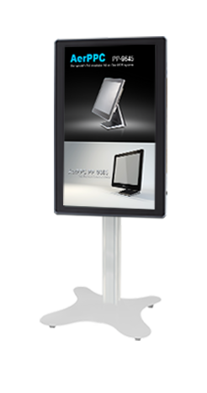
Applications
Kiosk

Slide 10
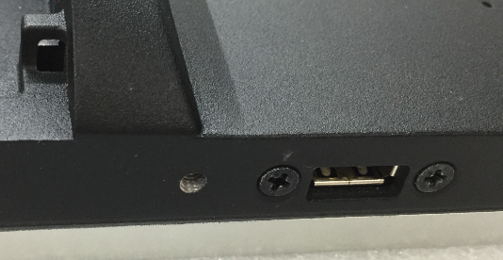
Service port
System maintenance
Convenience

Slide 11
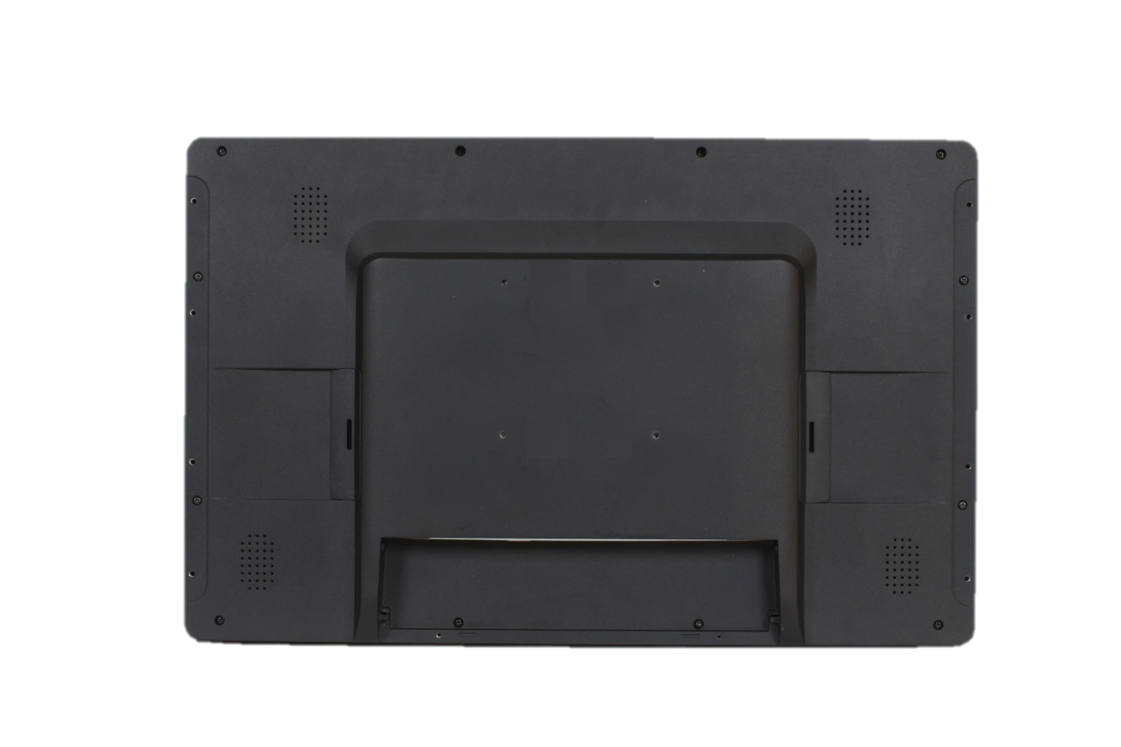
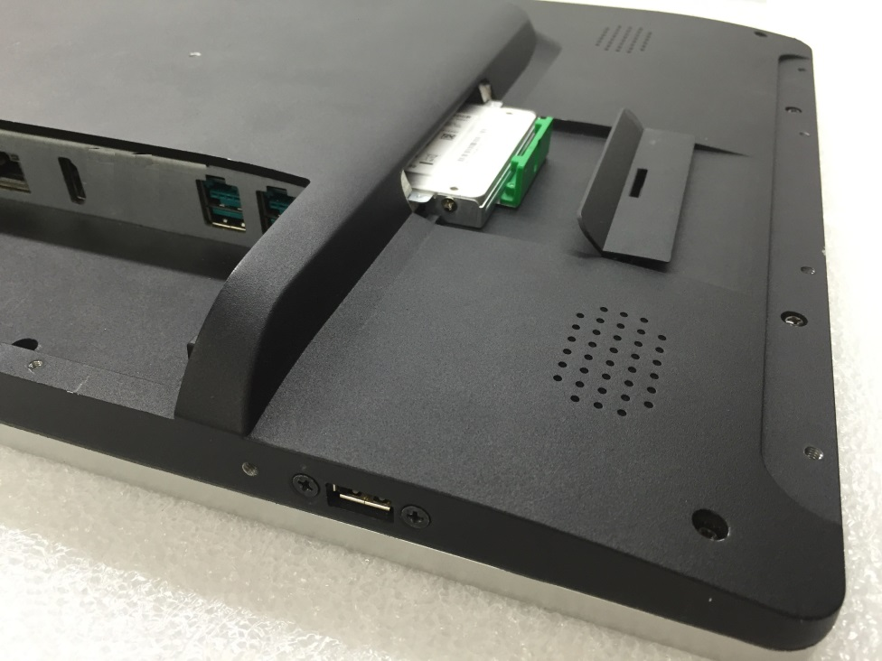
2.5” HDD & SSD Slot
Easy service access

Slide 12
Specifications
PP-8632SKU | PP-8632C3 | PP-8632C5 | PP-8632K5
Platform Processor | Bay Trial Celeron Quad Core J1900 CPU 2.0 Ghz
Memory | DDR3L Standard 4G ; Max 8G
Touch Display | Bezel Free P-Cap touch GG LED / 30K hours / 250nits | Bezel Free P-Cap touch GG LED / 50K hours / 300nits | Bezel Free P-Cap touch GG LED / 50K hours / 300nits
1st Storage | SATA Storage x 1 (HDD or SSD)
Contrast Ratio | 3000 : 1 | 5000 : 1
Power | 150W
Speaker | Yes |  | No
Optional IO | Type A, Type B, Type C

Slide 13

Default I/O SPEC
 |  | MB IO Connectivity (on board)
 |  | 12V DC In
 |  | Power USB 24V on board
 |  | Cash Drawer (12V/ 24V)
 |  | Giga LAN
 |  | VGA
 |  | USB 2.0 x 3
 |  | USB 3.0 x 1
 |  | COM Port RJ-45 (RI / 5V /12V)
 |  | HDMI Port
 |  | Line Out
 |  | 12V DC Out

Slide 14


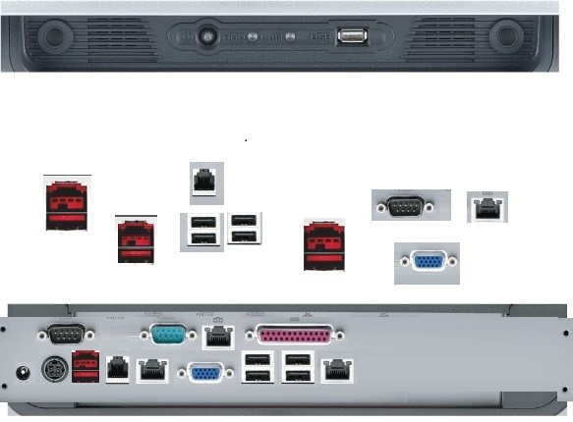


Option I/O SPEC
PP-8632 |  | Type A | COM(DB-9) x 2
PP-8632 |  | Type B | P-USB 12V x 2
PP-8632 |  | Type C | USB 2.0 x 2

Slide 15
Q & A

Slide 16
Thank you

Slide 17
ELEVATE YOUR BUSINESS

